Slide 1

Day 2
Intro to Classification Algorithms

Slide 2
Day 2 Outline
Day 1 Recap
Intro to Classifiers
K-Nearest Neighbors
Algorithm details
Choosing ”k”
Exercise
Pros/Cons
Probability
Probabilistic Classifiers
Probability Distributions
Exercise
Sample Spaces
Conditional Probability
Bayesian Inference
Naïve Bayes Classifier
Algorithm Details
Exercise
Pros/Cons
Logistic Regression
Algorithm Details
Exercise
Model Comparison

Slide 3
Day 1 Recap

Slide 4
Classification
Definition
Classification can take two distinct meanings in Machine Learning
Unsupervised Learning
We may be given a set of observations with the aim of establishing the existence of classes or clusters in the data
Supervised Learning
We may know for certain that there are so many classes, and the aim is to establish a rule that we can use to classify a new observation into one of the existing classes
Today we will be discussing methods and algorithms related to Supervised Classification

Slide 5
Classification
A few classification examples:
A Person arrives at the emergency room with a set of symptoms that could possibly be attributed to one of three medical conditions. Which of the three conditions does the individual have?
An online banking service must be able to determine whether or not a transaction being performed on the site is fraudulent, on the basis of the user’s IP address, past transaction history, and so forth.
On the basis of DN sequence data for a number of patients with and without a given disease, a biologist would like to figure out which DNA mutations are disease-causing and which are not.

Slide 6
Classification
There are many possible techniques that a classifier might use to predict a qualitative response. Today we will discuss three of the most widely-used classifiers:
k-Nearest Neighbors
Naïve Bayes
Logistic Regression

Slide 7
Classification
A few issues to keep in mind when building a classifier
Accuracy. There is the reliability of the rule, usually represented by the proportion of correct classifications, although it may be that some errors are more serious than others, and it may be important to control the error rate for some key class.
Speed. In some circumstances, the speed of the classifier is a major issue. A classifier that is 90% accurate may be preferred over one that is 95% accurate if it is 100 times faster in testing (and such differences in time-scales are not uncommon in neural networks for example). Such considerations would be important for the automatic reading of postal codes, or automatic fault detection of items on a production line for example.
Comprehensibility. If it is a human operator that must apply the classification procedure, the procedure must be easily understood else mistakes will be made in applying the rule. It is important also, that human operators believe the system.
Training Time. Especially in a rapidly changing environment, it may be necessary to learn a classification rule quickly, or make adjustments to an existing rule in real time. “Quickly” might imply also that we need only a small number of observations to establish our rule.[4]

Slide 8
K-Nearest Neighbors

Slide 9
Simple approach for k-NN
Simple goal:
Predict the label of a data point by:
Looking at the ‘k’ closest labeled data points (neighbors)
Taking a majority vote
One of the easiest algorithms to interpret, oftentimes used as a baseline for measuring model performance
Memory-Based Learning
Also known as “case-based” or “example-based” learning
Intuition behind memory-based learning
Similar inputs map to similar outputs
If true, we just have to define “similar”
Not all similarities created equal…

Slide 10
Memory-Based Learning
How do we determine “similar”?
For instance, if we wanted to:
Predict Brent’s weight
Who are the similar people?
Similar age, diet, height, waistline, activity level …
Predict Brent’s IQ
Similar occupation, writing style, undergraduate degree, SAT score, …
How would you quantify a comparison for these two?
Need some metric…
Distance?

Slide 11
kNN Model Representation
The model representation for KNN is the entire training dataset.
It is as simple as that.
KNN has no “model” other than storing the entire dataset, so there is no learning required.
Efficient implementations can store the data using complex data structures (k-d trees) to make look-up during prediction efficient.
Because the entire training dataset is stored, you may want to think carefully about the consistency of your training data. It might be a good idea to curate it, update it often as new data becomes available and remove erroneous and outlier data.

Slide 12
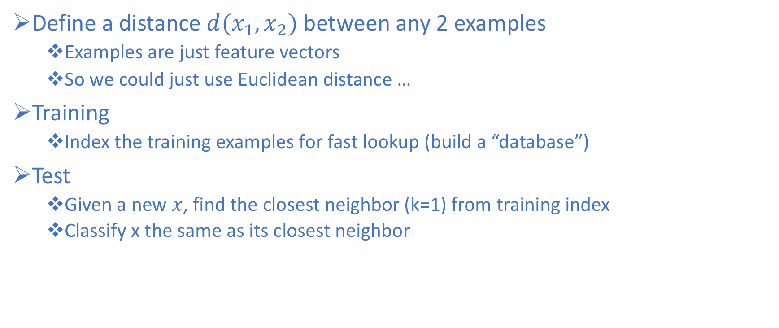
k-NN Approach
Define a distance $d(x_{1},x_{2})$between any 2 examples
Examples are just feature vectors
So we could just use Euclidean distance …
Training
Index the training examples for fast lookup (build a “database”)
Test
Given a new $x$, find the closest neighbor (k=1) from training index
Classify x the same as its closest neighbor

Slide 13
kNN
Instead of picking the (1) nearest neighbor, what if we picked the k-Nearest Neighbors and have them vote?
Choosing k points is more reliable in the following cases:
Noise in training vectors x
Noise in training labels y
Overlapping classes
o
+
o
o
o
k=1
o
o
o
o
o
o
+
+
x_2
o
o
o
o
+
+
+
+
+
+
+
+
x_1
+

Slide 14
kNN
Instead of picking the (1) nearest neighbor, what if we picked the k-Nearest Neighbors and have them vote?
Choosing k points is more reliable in the following cases:
Noise in training vectors x
Noise in training labels y
Overlapping classes
o
X
+
o
o
o
k=1
o
o
o
o
o
o
+
+
x_2
o
o
o
o
+
+
+
+
+
+
+
+
x_1
+

Slide 15
kNN
Instead of picking the (1) nearest neighbor, what if we picked the k-Nearest Neighbors and have them vote?
Choosing k points is more reliable in the following cases:
Noise in training vectors x
Noise in training labels y
Overlapping classes
Why?
o
X
+
o
o
o
k=1
o
o
o
o
o
o
+
+
x_2
o
o
o
o
+
+
+
+
+
+
+
+
x_1
+

Slide 16
kNN distance problem
Problem:
What if the input represents weight in milligrams?
Then small differences in physical weight dimension have a huge effect on distances, overwhelming other features
Should really correct for these arbitrary “scaling” issues
This leads to Standard Scaling (from yesterday)
Rescale weights so that standard deviation = 1
o
o
o
o
o
o
o
o
o
o
o
o
o
bad
o
o
o
o
o
attribute_2
o
+
attribute_2
o
o
o
+
+
+
+
+
+
+
+
+
+
+
+
+
+
+
+
+
weight (lb)
weight (mg)

Slide 17
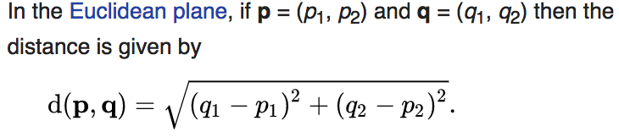
Making Predictions and Distance
KNN makes predictions using the training dataset directly.
Predictions are made for a new instance (x) by searching through the entire training set for the K most similar instances (the neighbors) and summarizing the output variable for those K instances.
For regression this might be the mean output variable, in classification this might be the mode (or most common) class value.
To determine which of the K instances in the training dataset are most similar to a new input a distance measure is used. For real-valued input variables, the most popular distance measure is Euclidean distance.
Euclidean distance is calculated as the square root of the sum of the squared differences between a new point (x) and an existing point (xi) across all input attributes j
In two dimensions:

Slide 18
Distance Metrics
Other popular distance metrics include:
Hamming Distance (Calculate the distance between binary vectors)
Manhattan Distance (Calculate the distance between real vectors using the sum of their absolute difference. Also called City Block Distance)
Minkowski Distance (Generalization of Euclidean and Manhattan Distance – Lp norm)
Other less-known distance metrics that can be used include Tanimoto, Jaccard, Mahalanobis, and cosine distance.
Generally
Euclidean is a good distance measure to use if the input variables are similar in type (e.g. all measured widths and heights).
Manhattan distance is a good measure to use if the input variables are not similar in type (such as age, gender, height, etc.).
If you are unsure, you can experiment with different distance metrics and different values of K together and see which mix results in the most accurate models.

Slide 19
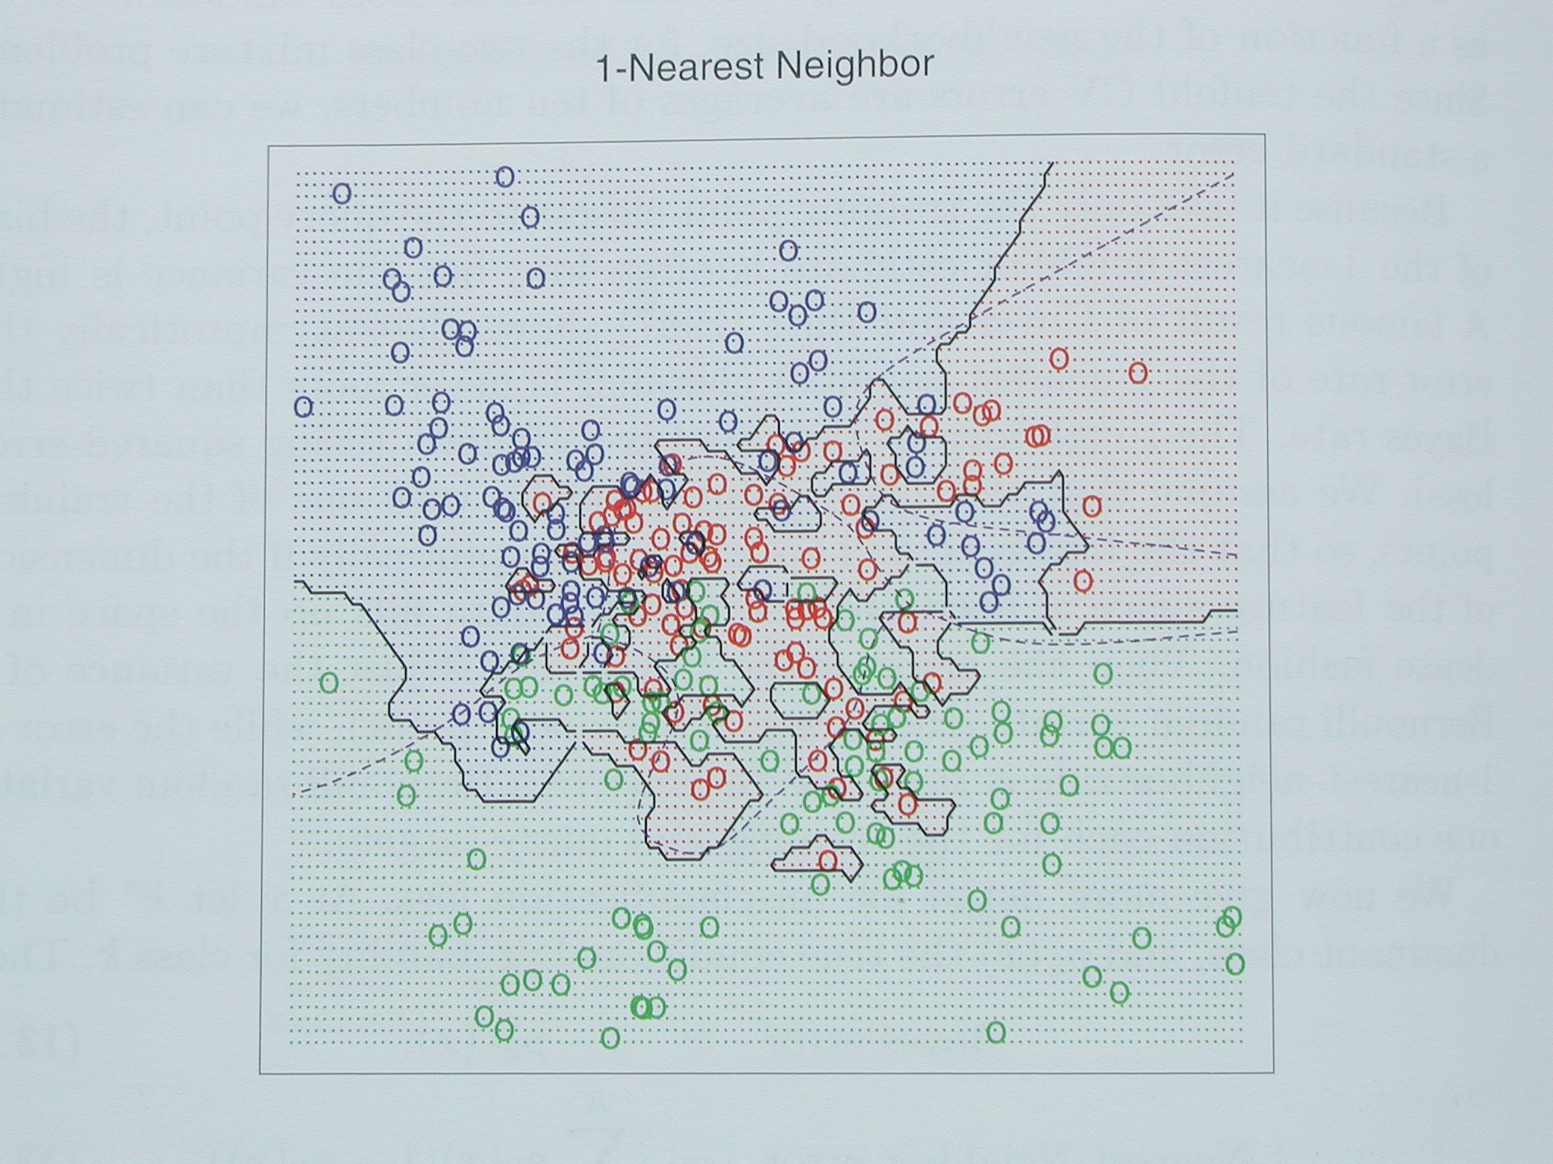
kNN Decision Boundaries
kNN can learn complex decision boundaries

Slide 20
kNN Decision Boundaries
Consider this example with R,G,B classes with significant overlap

Slide 21
kNN Decision Boundaries
Consider this example with R,G,B classes with significant overlap
k=1 Decision Boundary
Looks complex
Overfitting?

Slide 22
kNN Decision Boundaries
k=1 Decision Boundary
Looks complex
Overfitting?
What if we were to increase k?

Slide 23
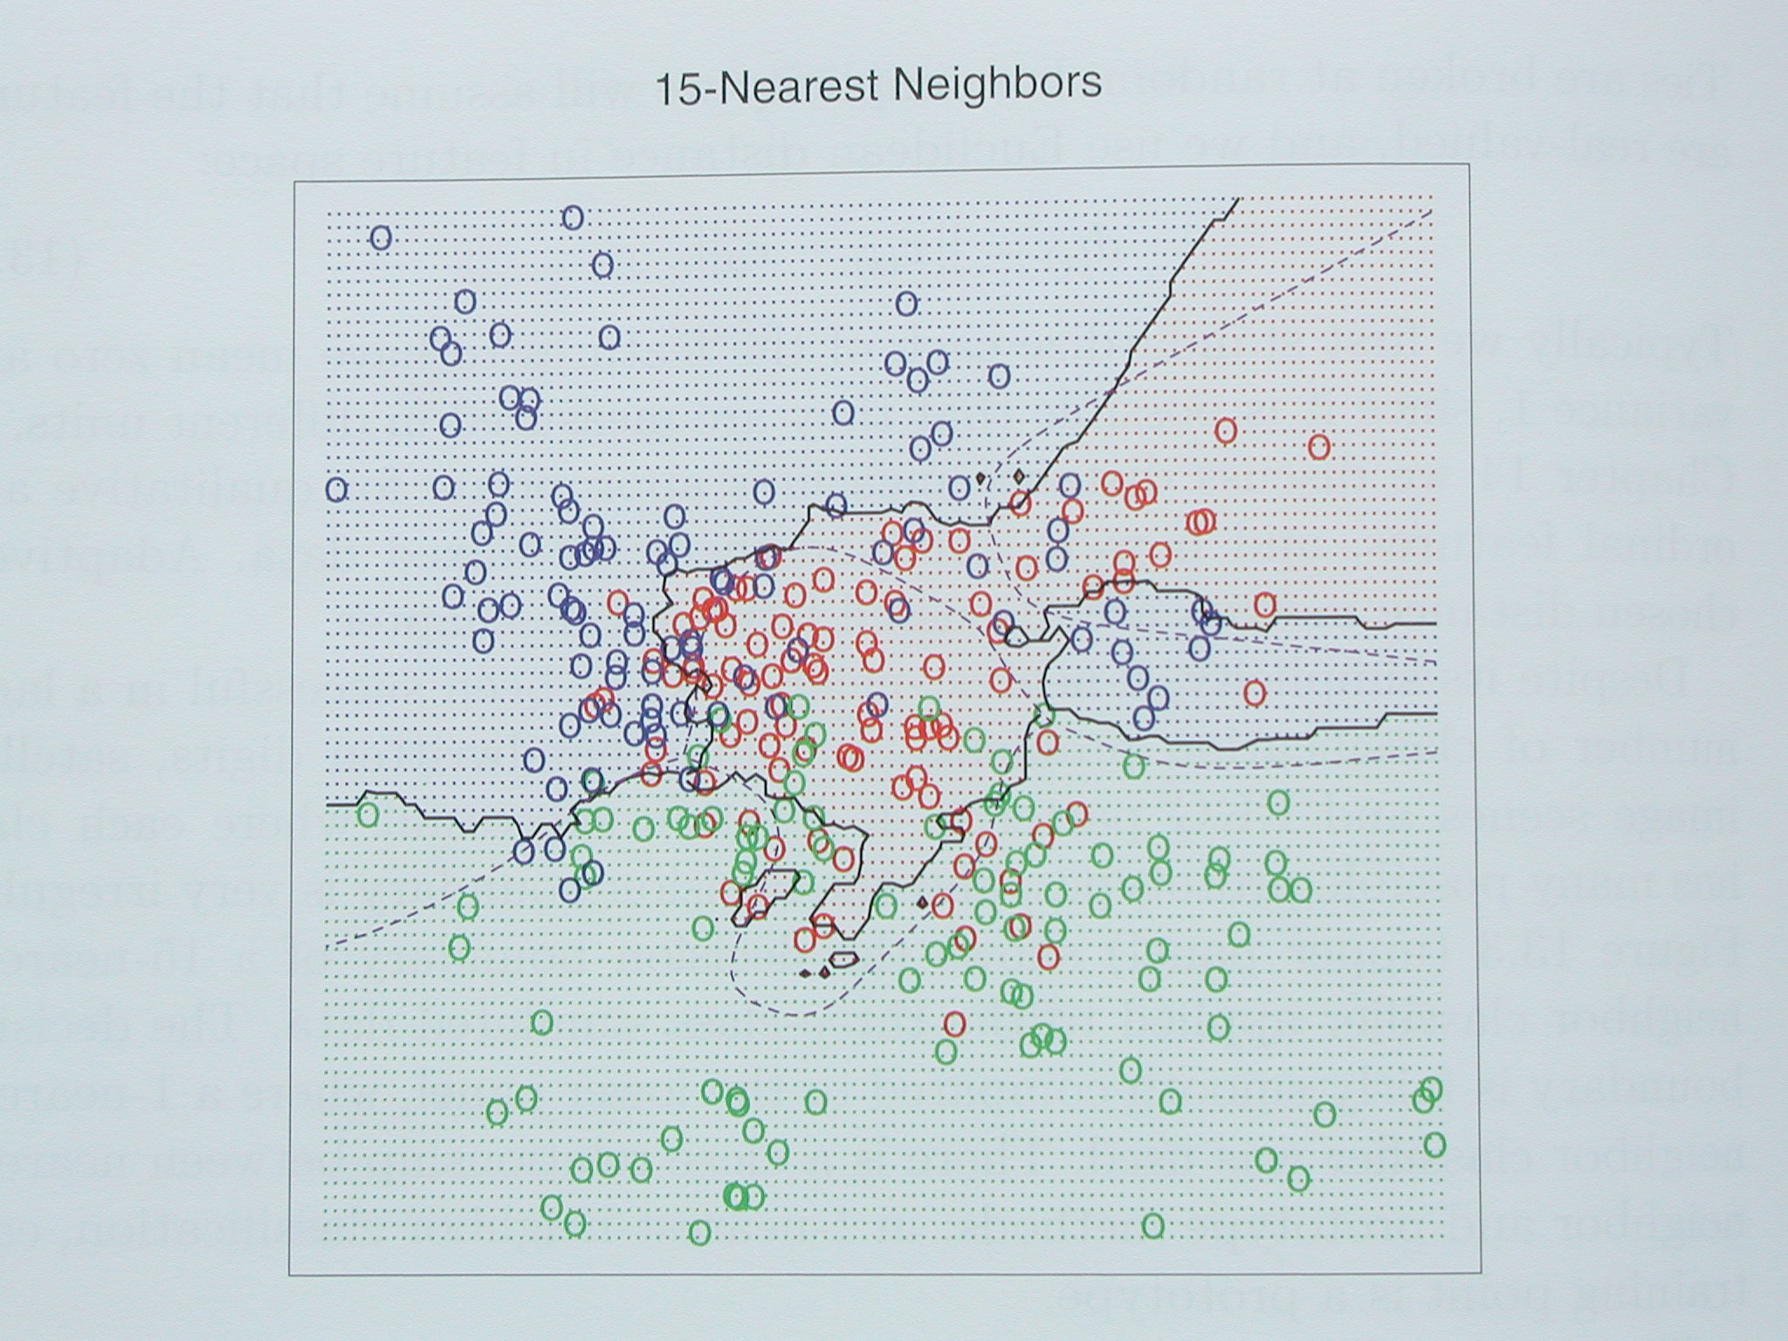
kNN Decision Boundaries
k=1 Decision Boundary
Looks complex
Overfitting?
What if we were to increase k?
K=15 Decision boundary

Slide 24
kNN Decision Boundaries
k=1 Decision Boundary
Looks complex
Overfitting?
What if we were to increase k?
K=15 Decision boundary
Smoother boundaries

Slide 25
kNN Decision Boundaries
k=1 Decision Boundary
Looks complex
Overfitting?
What if we were to increase k?
K=15 Decision boundary
Smoother boundaries
Generalizes better on unseen data

Slide 26
kNN Decision Boundaries
k=1 Decision Boundary
Looks complex
Overfitting?
What if we were to increase k?
K=15 Decision boundary
Smoother boundaries
Generalizes better on unseen data
What makes the boundaries smoother?

Slide 27
kNN Decision Boundaries
k=1 Decision Boundary
Looks complex
Overfitting?
What if we were to increase k?
K=15 Decision boundary
Smoother boundaries
Generalizes better on unseen data
What makes the boundaries smoother?
Let’s look at a two-class (binary) example

Slide 28
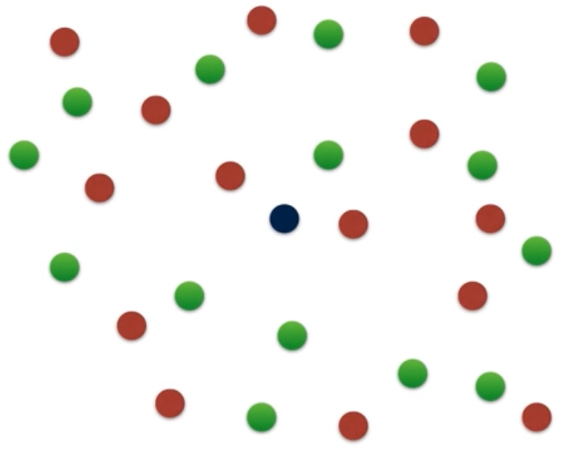
k-NN Graphical Example
Consider this two-dimensional dataset with points classified as Red or Green

Slide 29
k-NN Graphical Example
Consider this two-dimensional dataset with points classified as Red or Green
We want to Classify this point

Slide 30
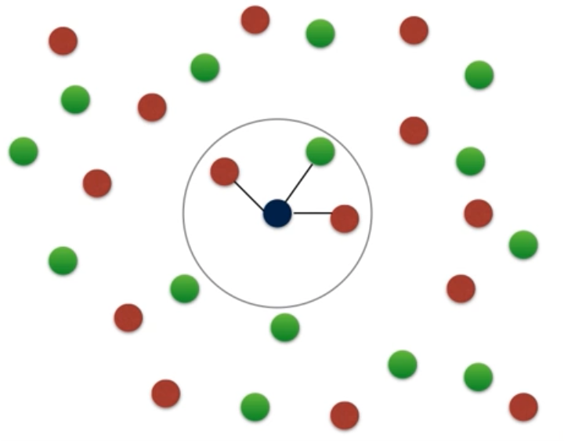
k-NN Graphical Example
Consider this two-dimensional dataset with points classified as Red or Green
We want to Classify this point
If we consider k=3 neighbors

Slide 31
k-NN Graphical Example
Consider this two-dimensional dataset with points classified as Red or Green
We want to Classify this point
If we consider k=3 neighbors
Measured by some distance
d

Slide 32
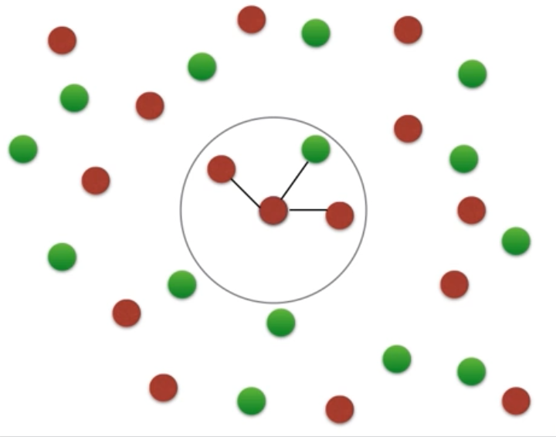
k-NN Graphical Example
Consider this two-dimensional dataset with points classified as Red or Green
We want to Classify this point
If we consider k=3 neighbors
Measured by some distance
The point is classified as Red

Slide 33
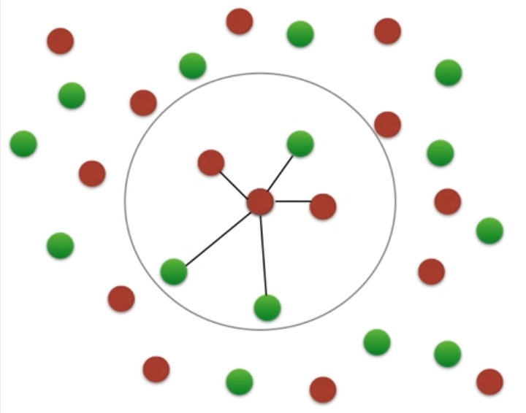
k-NN Graphical Example
Consider this two-dimensional dataset with points classified as Red or Green
We want to Classify this point
If we consider k=3 neighbors
Measured by some distance
The point is classified as Red
If we consider k=5 neighbors

Slide 34
k-NN Graphical Example
Consider this two-dimensional dataset with points classified as Red or Green
We want to Classify this point
If we consider k=3 neighbors
Measured by some distance
The point is classified as Red
If we consider k=5 neighbors
Measured by some distance
d

Slide 35
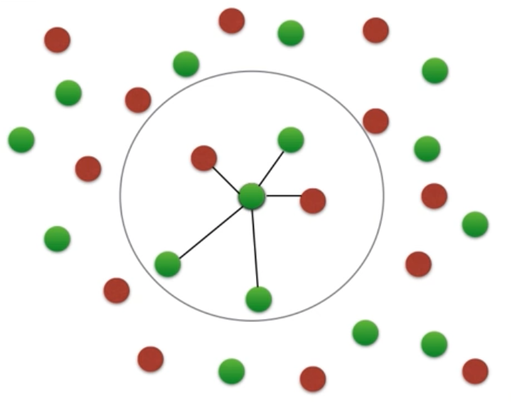
k-NN Graphical Example
Consider this two-dimensional dataset with points classified as Red or Green
We want to Classify this point
If we consider k=3 neighbors
Measured by some distance
The point is classified as Red
If we consider k=5 neighbors
Measured by some distance
The point is classified as Green

Slide 36
k-NN Graphical Example
Consider this two-dimensional dataset with points classified as Red or Green
We want to Classify this point
If we consider k=3 neighbors
Measured by some distance
The point is classified as Red
If we consider k=5 neighbors
Measured by some distance
The point is classified as Green
So, how do we know what k to choose?

Slide 37
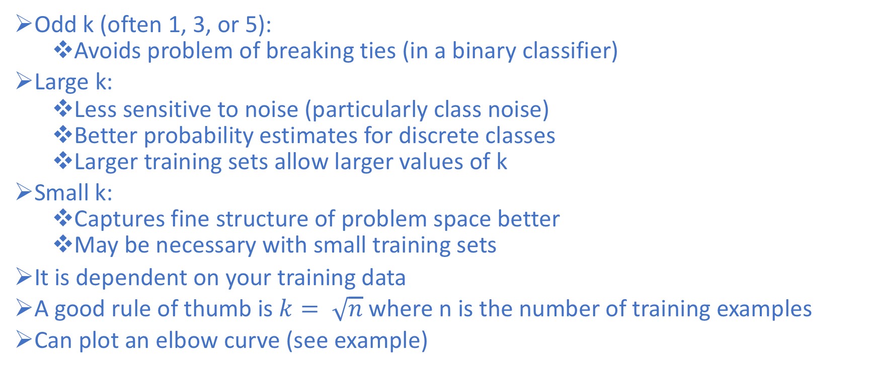
How to choose “k”
Odd k (often 1, 3, or 5):
Avoids problem of breaking ties (in a binary classifier)
Large k:
Less sensitive to noise (particularly class noise)
Better probability estimates for discrete classes
Larger training sets allow larger values of k
Small k:
Captures fine structure of problem space better
May be necessary with small training sets
It is dependent on your training data
A good rule of thumb is $k= \sqrt{n}$where n is the number of training examples
Can plot an elbow curve (see example)

Slide 38
Best Preparation of Data for kNN
Rescale Data: KNN performs much better if all of the data has the same scale.
Scaling (Min/Max) your data to the range [0, 1] is a good idea.
It may also be a good idea to standardize your data if it has a Gaussian distribution.
Address Missing Data: Missing data will mean that the distance between samples can not be calculated. These samples should either be excluded (dropped) or the missing values could be imputed.
Lower Dimensionality: KNN is best suited for lower dimensional data. You can try it on high dimensional data (hundreds or thousands of input variables) but be aware that it may not perform as well as other techniques. KNN can benefit from feature selection that reduces the dimensionality of the input feature space.

Slide 39
Recap/Summary of kNN
Nonparametric - makes no explicit assumptions about the underlying distribution of the input
Instance/memory-based learning means that this algorithm doesn’t explicitly learn a model. Instead, it chooses to memorize the training instances which are subsequently used as “knowledge” for the prediction phase
Learns arbitrarily complicated decision boundaries
Lazy learner - a learning method that generalizes data in the testing phase, rather than during the training phase
Don’t do any work until you know what you want to predict
A benefit of lazy learning is that it can quickly adapt to changes, since it is not expecting a certain generalized dataset.
Very fast training time, but very slow prediction (has to search for the nearest neighbors)

Slide 40
Advantages of k-NN
Simple and fast to deploy
Little to no training time
Easy to interpret/explain
Naturally handles multiclass datasets
Non-parametric
Does not assume any probability distributions on the input data

Slide 41
Disadvantages of k-NN
Storage of model takes a lot of disk space (contains entire training dataset)
Curse of Dimensionality - often works best with 25 or fewer dimensions
There is little difference between the nearest and farthest neighbor in high dimensional data
Computationally expensive predictions (large search problem to find nearest neighbors)
Might be impractical in industry settings
Need to normalize - suffers from skewed class distributions
If one type of category occurs much more than another, classifying an input will be more biased towards that one category (dominates the majority vote since it is more likely to be neighbors with the input)

Slide 42
kNN Exercise

Slide 43
Naïve Bayes

Slide 44
Naïve Bayes
Naive Bayes is a simple classification technique that relies on conditional probability, and predicts the most probable class given a set of inputs
It is often used as a baseline for more complex models

Slide 45
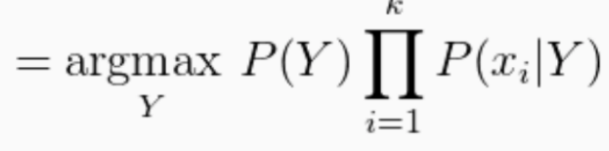
A new method: Naïve Bayes
Naive Bayes is a simple technique for predicting the most probable class/label given a set of features/inputs
It is often used as a baseline for more complex models
How can we unpack this?

Slide 46
Understanding Naïve Bayes Classifiers
To be able to unpack the Naïve Bayes classifier definition, we need a good grasp on the following topics
Random variables
Distributions
Continuous
Discrete
Statistical Independence
Probability
Conditional Probability
Joint Probability
Marginal Probability

Slide 47
Random Variables
A random variable is a random number determined by chance, or more formally, drawn according to a probability distribution which specifies the probability that its value falls in any given interval.
Discrete Random Variable
Taking any of a specified finite or countable list of values, endowed with a probability mass function characteristic of the random variable's probability distribution
Continuous
Taking any numerical value in an interval or collection of intervals, via a probability density function that is characteristic of the random variable's probability distribution; or a mixture of both types.

Slide 48
Random Variables
Why do we care about Random Variables?
Our goal is to predict the target/class
We are not given the true (presumably deterministic) function
We are only given observations
Uncertainty arises through:
Noisy measurements
Finite size of data sets
Ambiguity: The word “bank” can mean (1) a financial institution, (2) the side of a river,or (3) tilting an airplane. Which meaning was intended, based on the words that appear nearby?
Probability theory provides a consistent framework for the quantification and manipulation of uncertainty
Allows us to make optimal predictions given all the information available to us, even though that information may be incomplete or ambiguous

Slide 49
Probability
Probabilities assign numbers to possibilities
A probability needs to satisfy three properties (Kolmogorov, 1956):
A probability must be nonnegative
The sum of the probabilities across all events in the entire sample space must be 1
For any two mutually exclusive events, the probability that one or the other occurs is the sum of their individual probabilities
For example, the probability that a fair six-sided die comes up 3 OR 4 is 1/6 + 1/6 = 2/6.

Slide 50
Probability Distributions
A probability distribution is simply a list of all possible events and their corresponding probabilities
There are two kinds of probability distributions
Discrete Distribution:
Probability of heads or tails
Continuous Distribution:
Probabilities of people’s heights

Slide 51
Discrete Probability Distribution
When the sample space consists of discrete outcomes (e.g., heads or tails), the probability distribution is a list of probabilities of the outcomes
The probability of a discrete outcome is called a probability mass
The sum of the probability masses across the sample space must be 1

Slide 52
Discrete Probability Example
Example
Consider the simple experiment of tossing a coin three times. Let X = number of times the coin comes up heads. The 8 possible elementary events and the corresponding values for X are:
Elementary Event | Count of Heads (X)
TTT | 0
TTH | 1
THT | 1
HTT | 1
THH | 2
HTH | 2
HHT | 2
HHH | 3

Slide 53
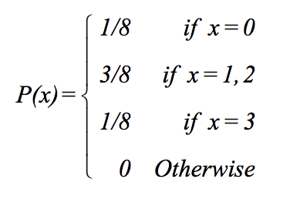
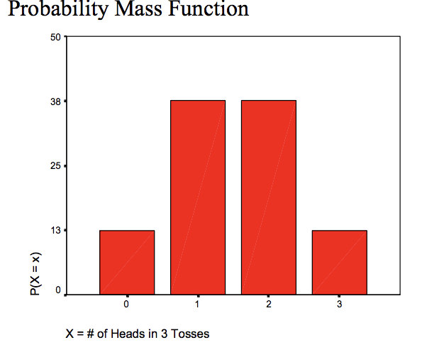
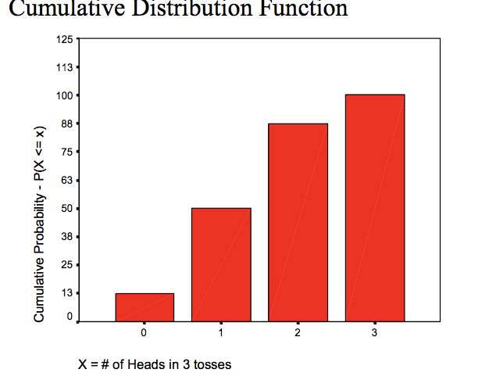
Discrete Probability Example
Example
Therefore, the probability distribution for the number of heads occurring in three coin tosses is
Count of Heads (X) | p(x) | F(x)
0 | 1/8 | 1/8
1 | 3/8 | 4/8
2 | 3/8 | 7/8
3 | 1/8 | 1

Slide 54
Continuous Probability Distribution
When the sample space consists of continuous outcomes (ex: people’s heights) we cannot use probability mass for a specific outcome.
Why not?

Slide 55
Continuous Probability Distribution – Probability Density
When the sample space consists of continuous outcomes (ex: people’s heights) we cannot use probability mass for a specific outcome.
Why not?
Because the probability mass for a specific outcome will be zero
In other words, the probability of someone’s height being exactly 67.2141390842076153…
Instead, we can:
Discretize the space into a finite set of mutually exclusive and exhaustive intervals
Calculate the probability mass in each interval
Use the ratio of probability mass to interval width
This ratio is called the Probability Density

Slide 56
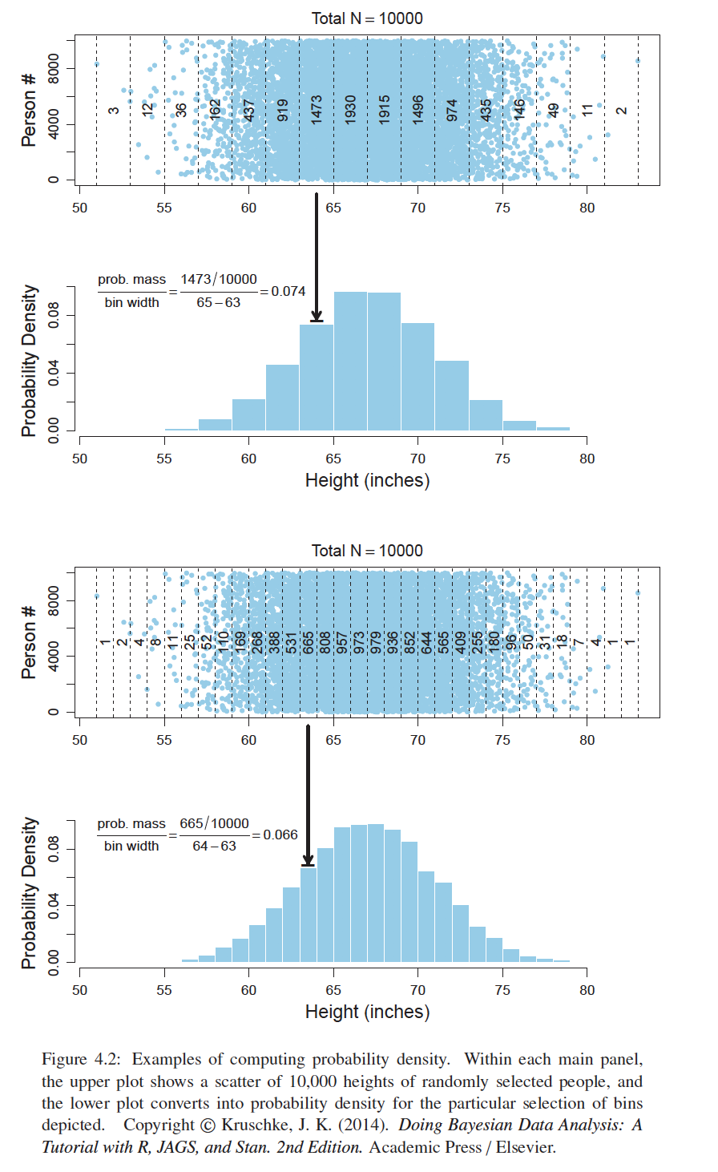
Probability Density
The top panel of this figure shows the discretized intervals and probability mass in each interval
The second panel shows the probability density
The third panel shows the narrower intervals and probability mass in each interval
The bottom panel shows the probability density corresponding to the more narrow intervals
Generally, the skinnier the intervals are, the more accurate the probability density is

Slide 57
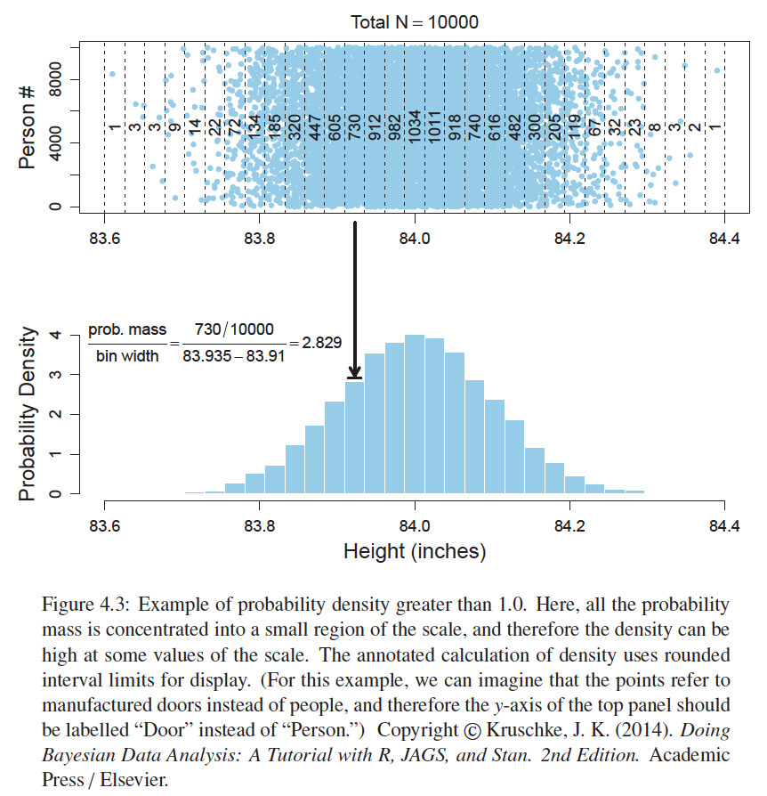
Probability Density
While probability mass cannot exceed 1, probability densities can
The upper panel of this figure shows that most of the probability mass is concentrated around 84
Consequently, the probability density near 84 exceeds 1.0, as shown in the lower panel
This simply means that there is a high concentration of probability mass relative to the width of the interval

Slide 58
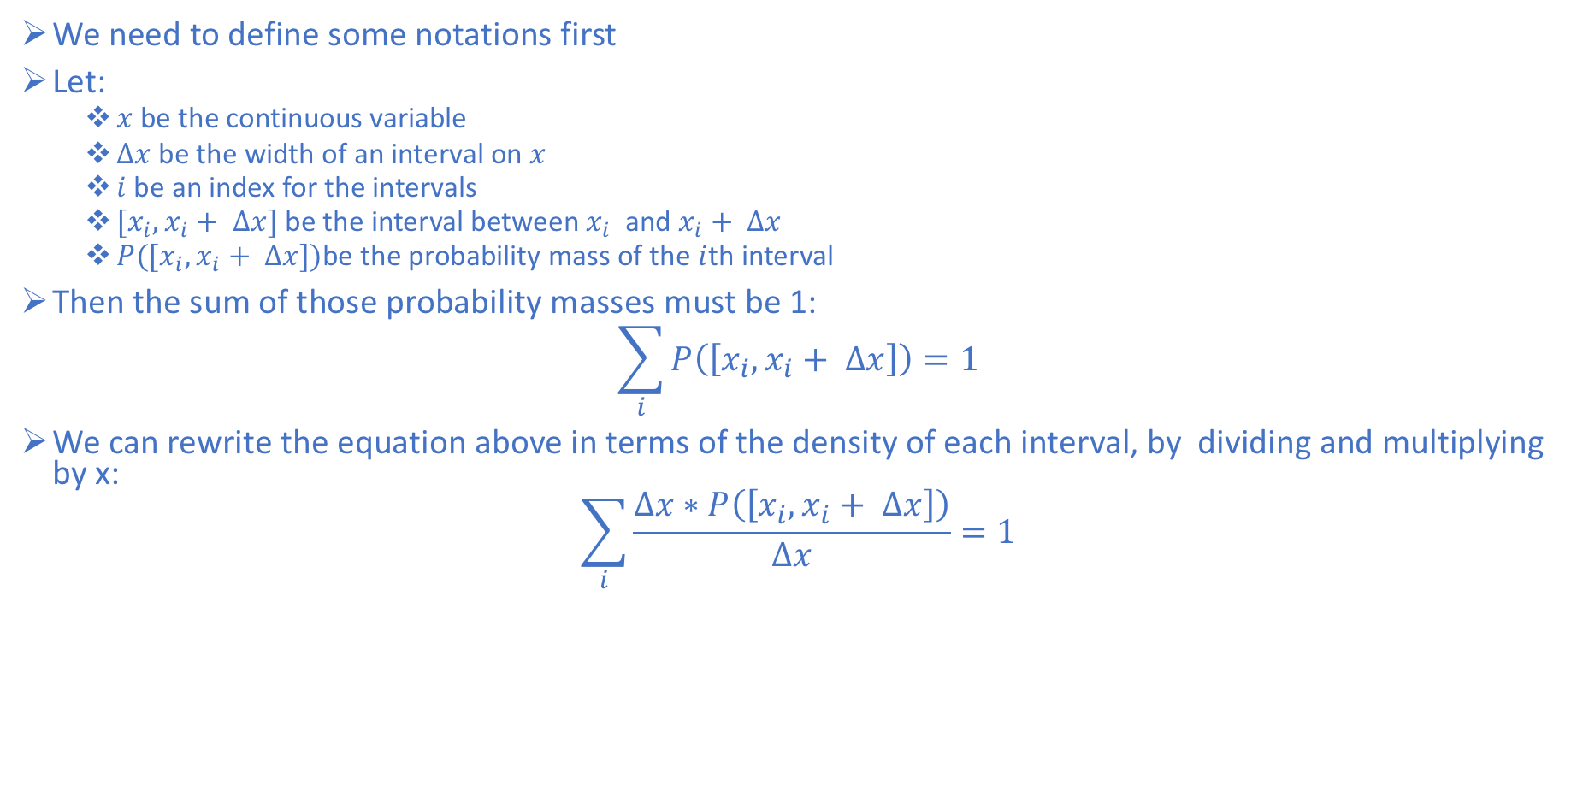
Properties of Probability Density Functions
We need to define some notations first
Let:
$x$ be the continuous variable
$Δx$ be the width of an interval on $x$
$i$ be an index for the intervals
$[x_{i},x_{i}+ ∆x]$ be the interval between $x_{i}$ and $x_{i}+ ∆x$
$P([x_{i},x_{i}+ ∆x])$be the probability mass of the $i$th interval
Then the sum of those probability masses must be 1:
$$\sum_{i}{P\left(\left[x_{i},x_{i}+ ∆x\right]\right)=1}$$
We can rewrite the equation above in terms of the density of each interval, by dividing and multiplying by x:
$$\sum_{i}{\frac{∆x∗P\left(\left[x_{i},x_{i}+ ∆x\right]\right)}{∆x}=1}$$

Slide 59
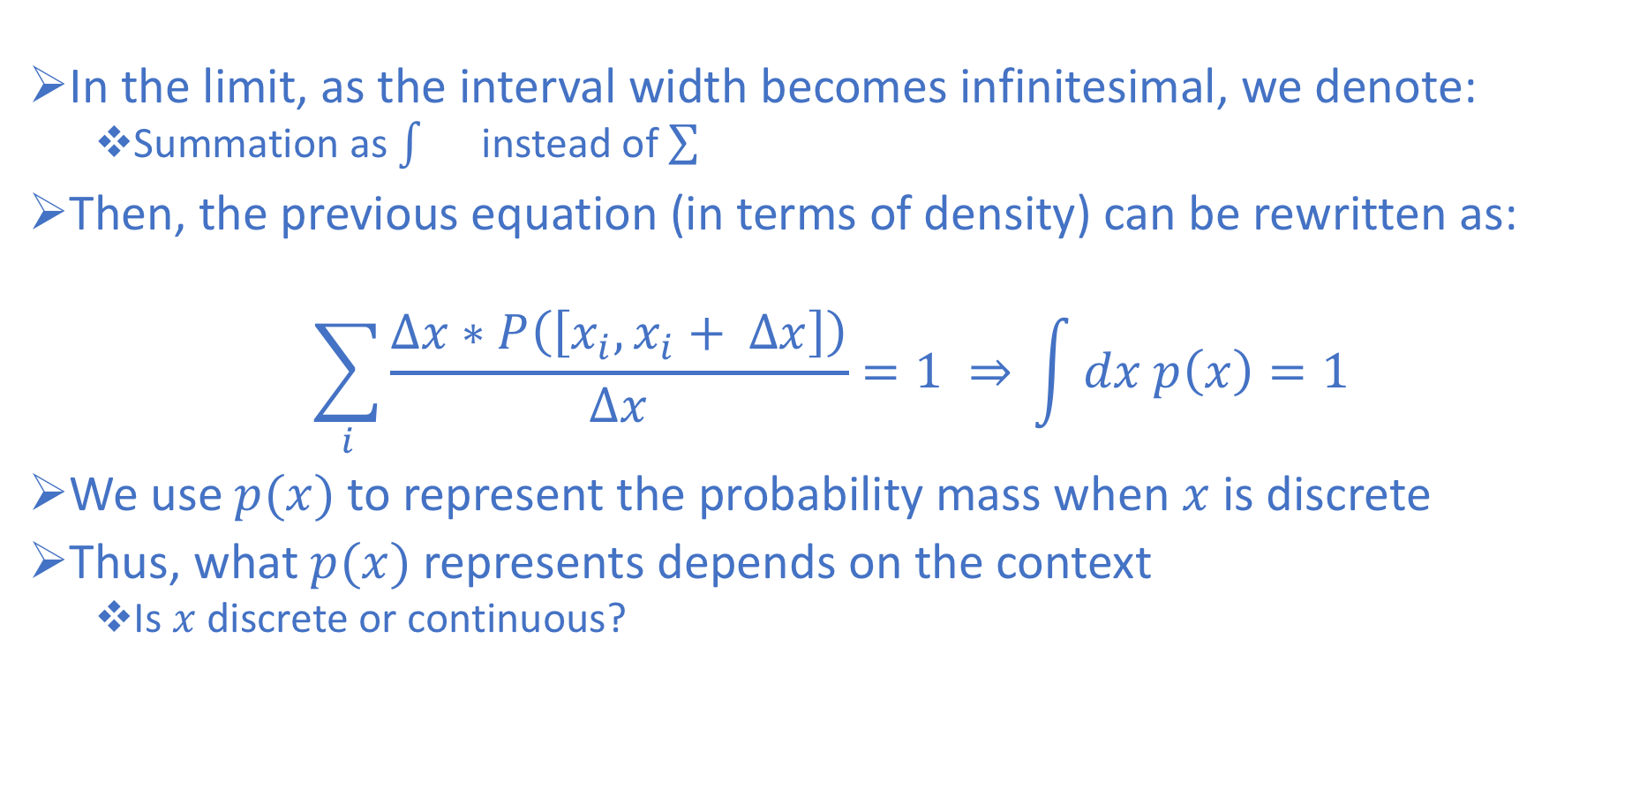
Properties of Probability Density Functions
In the limit, as the interval width becomes infinitesimal, we denote:
Summation as instead of
Then, the previous equation (in terms of density) can be rewritten as:
$$\sum_{i}{\frac{∆x∗P\left(\left[x_{i},x_{i}+ ∆x\right]\right)}{∆x}=1 ⇒} \int{dx p\left(x\right)=1}$$
We use$p(x)$to represent the probability mass when $x$ is discrete
Thus, what $p(x)$represents depends on the context
Is $x$ discrete or continuous?

Slide 60
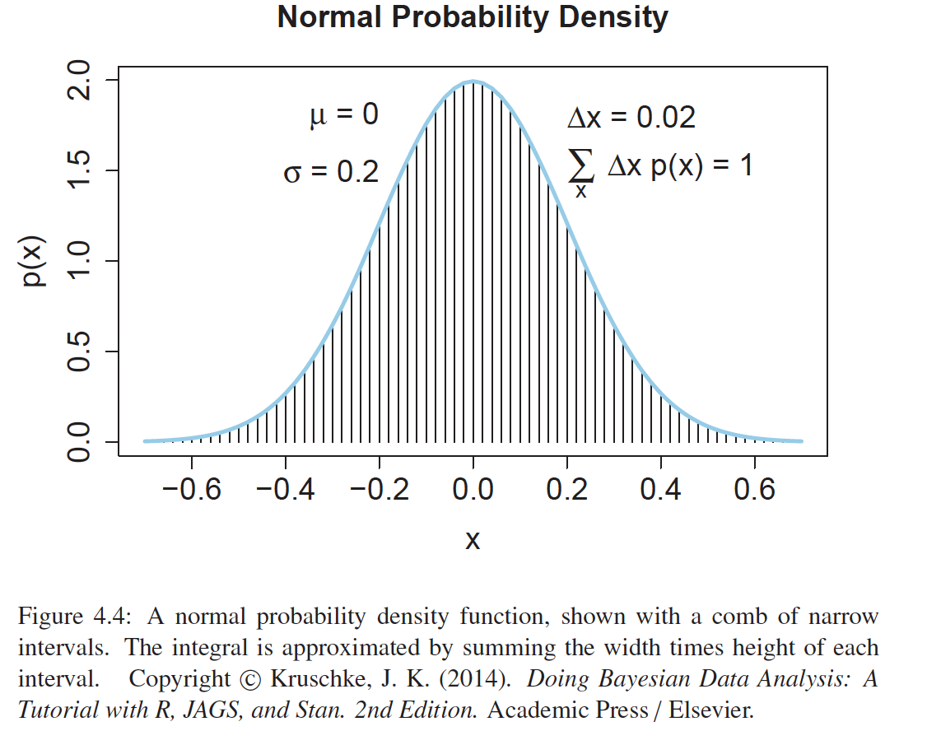
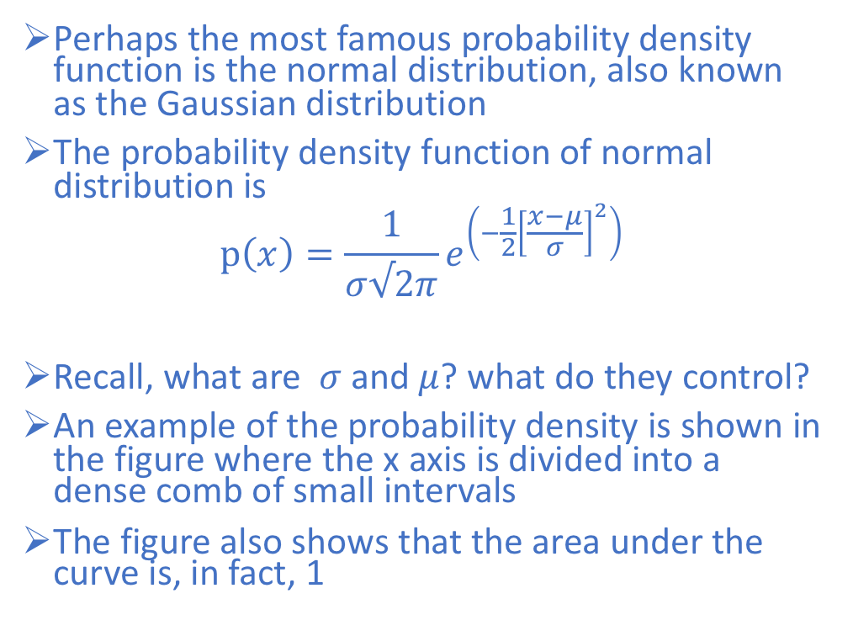
The Normal Probability Density Functions
Perhaps the most famous probability density function is the normal distribution, also known as the Gaussian distribution
The probability density function of normal distribution is
$$p\left(x\right)=\frac{1}{σ√2π}e^{\left(−\frac{1}{2}{\left[\frac{x−μ}{σ}\right]}^{2}\right)}$$
Recall, what are $σ$and $μ$? what do they control?
An example of the probability density is shown in the figure where the x axis is divided into a dense comb of small intervals
The figure also shows that the area under the curve is, in fact, 1

Slide 61
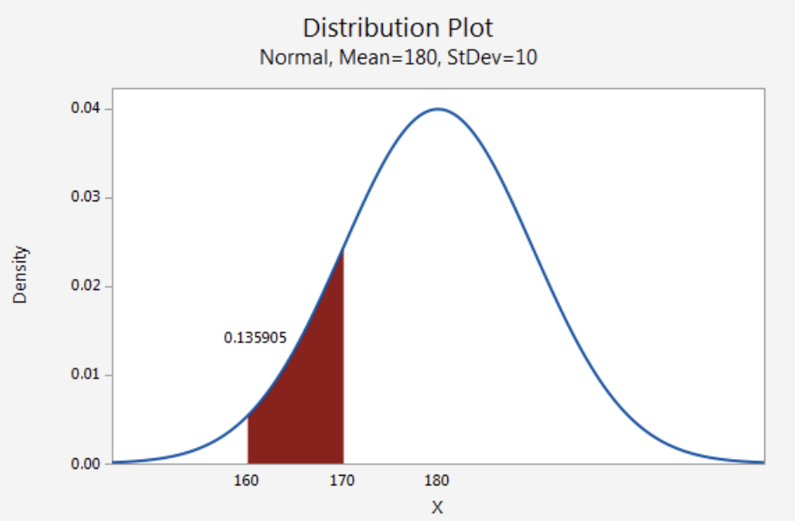
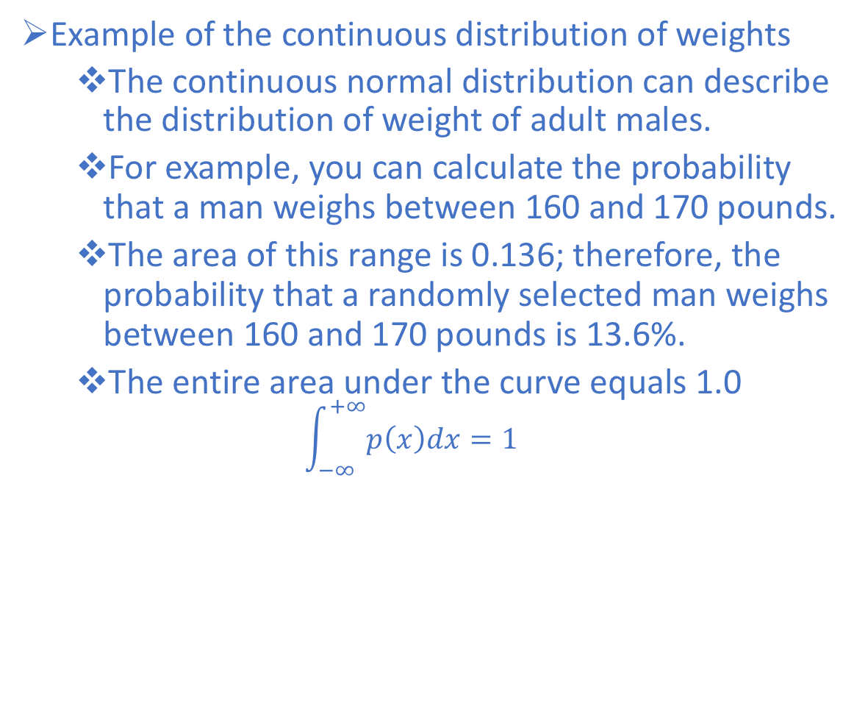
Example - Continuous Normal Distribution
Example of the continuous distribution of weights
The continuous normal distribution can describe the distribution of weight of adult males.
For example, you can calculate the probability that a man weighs between 160 and 170 pounds.
The area of this range is 0.136; therefore, the probability that a randomly selected man weighs between 160 and 170 pounds is 13.6%.
The entire area under the curve equals 1.0
$$\int_{−∞}^{+∞}{p\left(x\right)dx=1}$$
Notes:
However, the probability that X is exactly equal to some value is always zero because the area under the curve at a single point, which has no width, is zero.
For example, the probability that a man weighs exactly 190 pounds to infinite precision is zero.
You could calculate a nonzero probability that a man weighs more than 190 pounds, or less than 190 pounds, or between 189.9 and 190.1 pounds, but the probability that he weighs exactly 190 pounds is zero.

Slide 62
Random Variables/Distributions Exercise

Slide 63
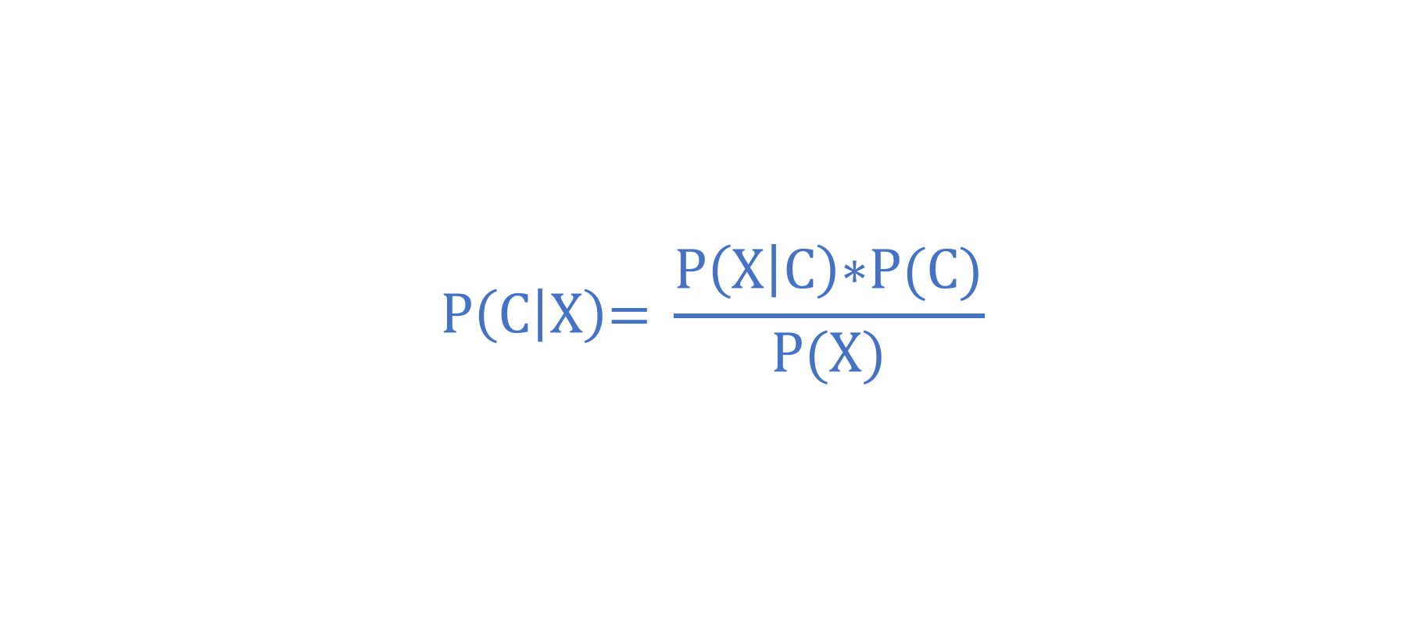
Bayes Rule (Just a preview)
Bayes rule is merely the mathematical relation between the prior allocations of credibility and the posterior reallocation of credibility (conditional on data)
$$\text{P}\left(\text{C} | \text{X}\right)\text{= }\frac{\text{P}\left(\text{X} | \text{C}\right)\text{∗}\text{P}\text{(}\text{C}\text{)}}{\text{P}\text{(}\text{X}\text{)}}$$

Slide 64
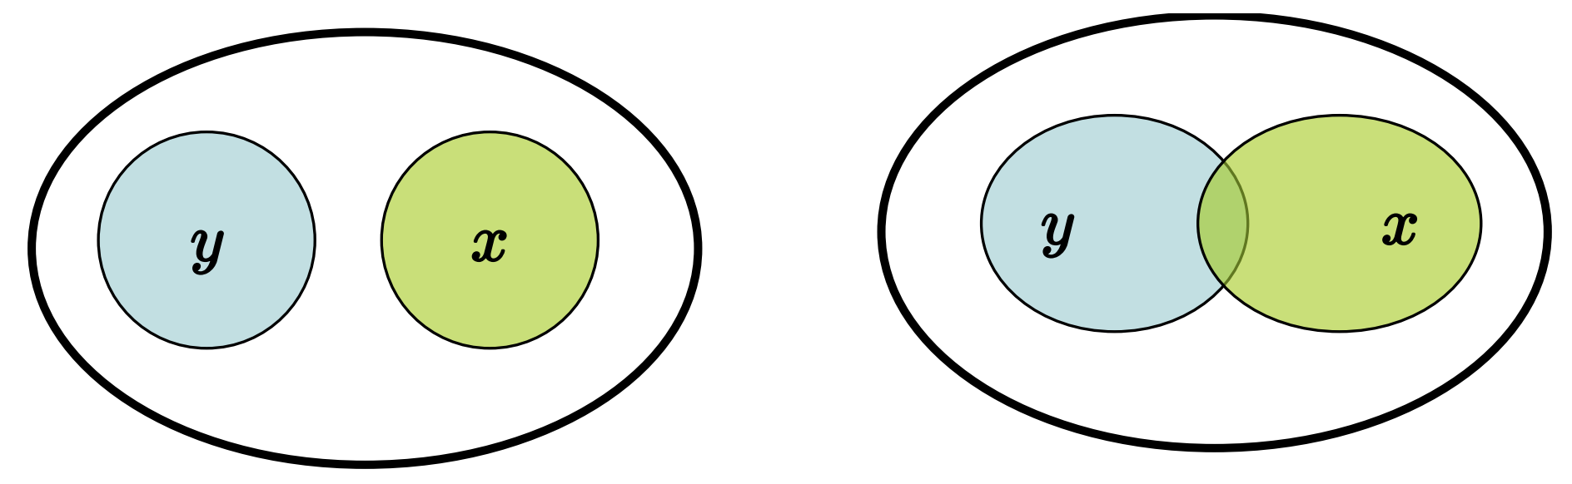
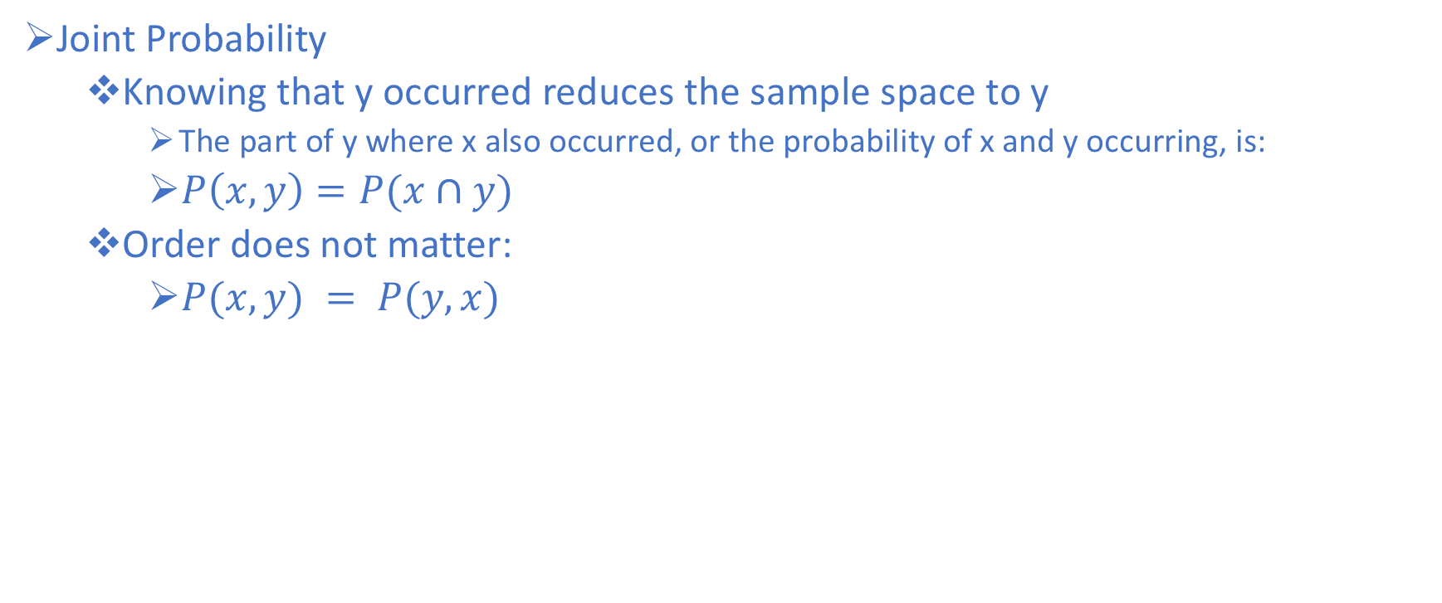
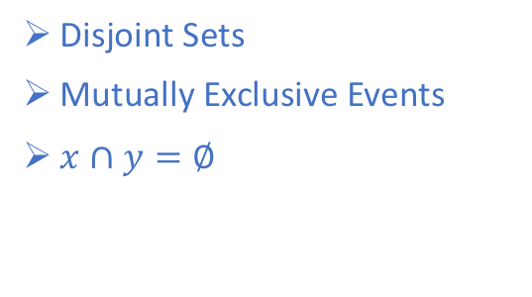
Joint Probability
Joint Probability
Knowing that y occurred reduces the sample space to y
The part of y where x also occurred, or the probability of x and y occurring, is:
$P\left(x,y\right)=P(x∩y)$
Order does not matter:
$P(x,y) = P(y,x)$
Disjoint Sets
Mutually Exclusive Events
$x∩y=∅$
Intersecting sets

Slide 65
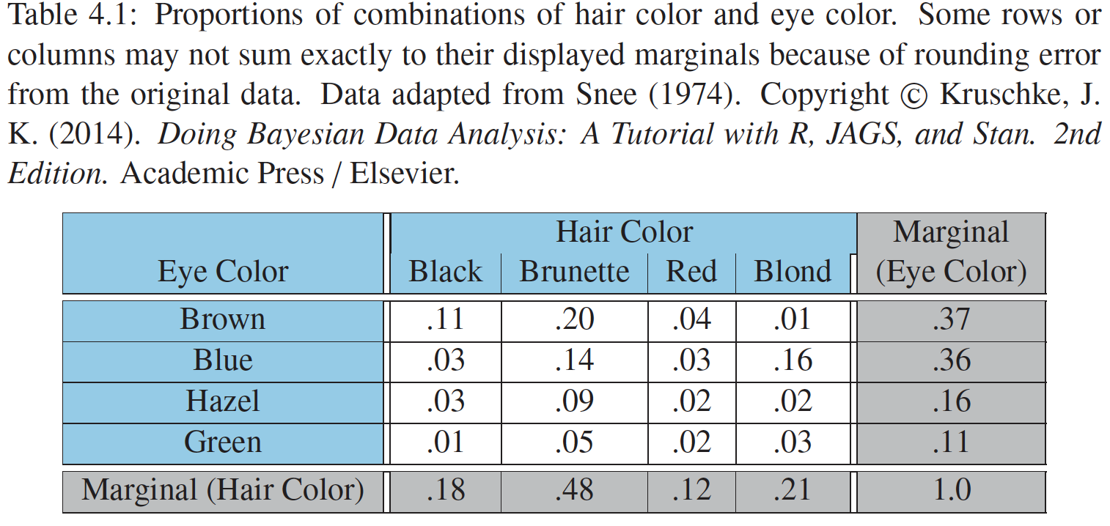
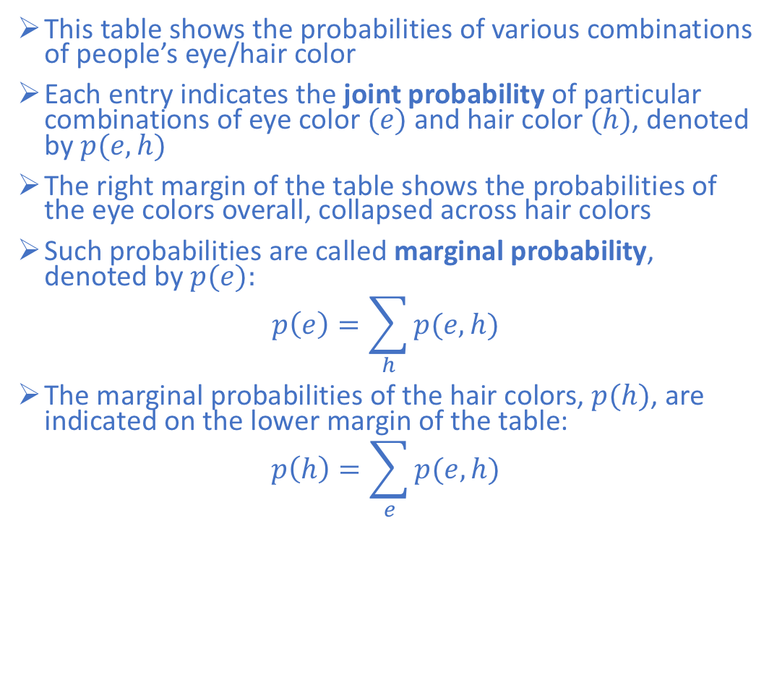
Joint Probability and Marginal Probability
This table shows the probabilities of various combinations of people’s eye/hair color
Each entry indicates the joint probability of particular combinations of eye color $(e)$and hair color $(h)$, denoted by $p(e,h)$
The right margin of the table shows the probabilities of the eye colors overall, collapsed across hair colors
Such probabilities are called marginal probability, denoted by $p(e):$
$$p\left(e\right)=\sum_{h}{p(e,h)}$$
The marginal probabilities of the hair colors, $p(h)$, are indicated on the lower margin of the table:
$$p\left(h\right)=\sum_{e}{p(e,h)}$$

Slide 66
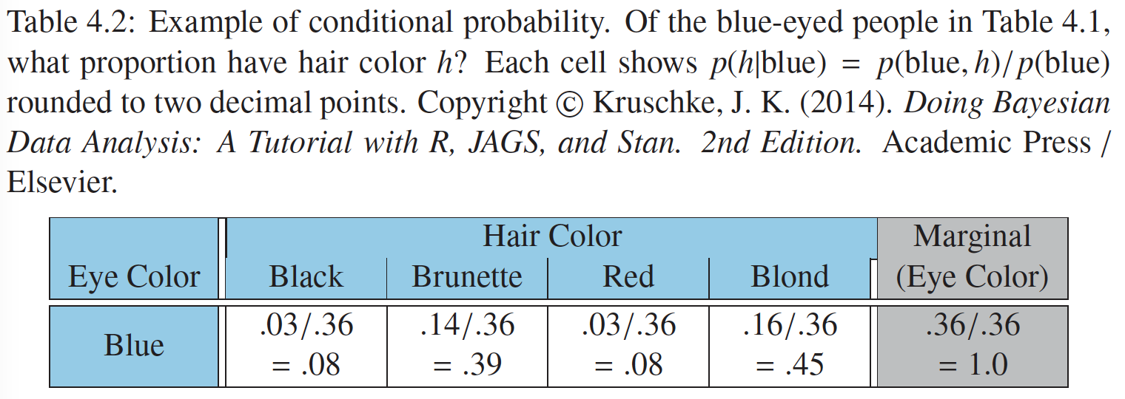
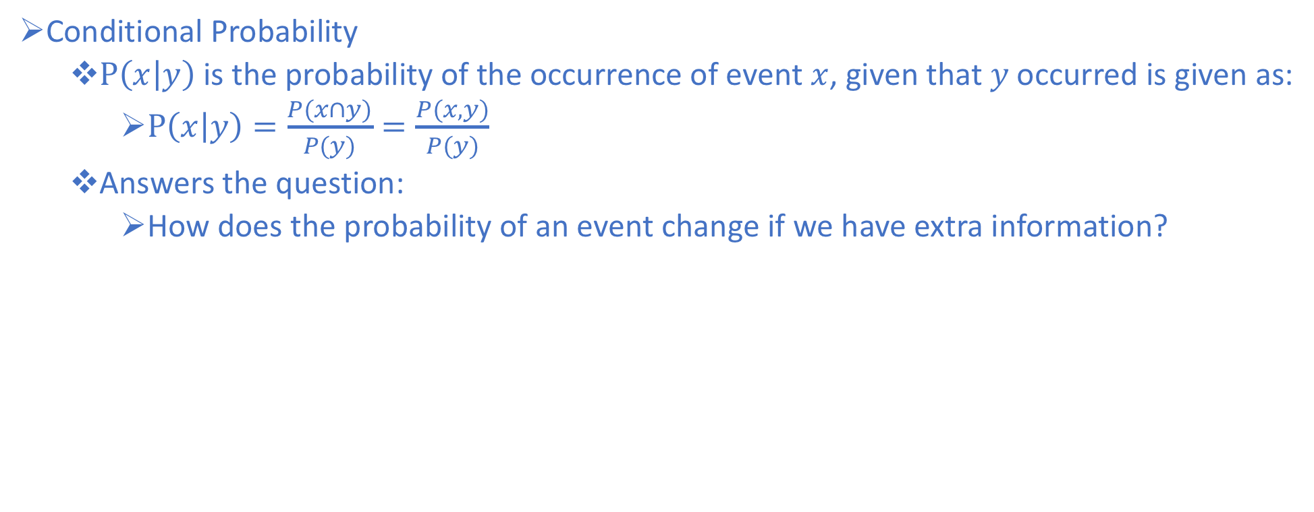
Conditional Probability
Conditional Probability
$P\left(x | y\right)$is the probability of the occurrence of event $x$, given that $y$ occurred is given as:
$P\left(x | y\right)=\frac{P(x∩y)}{P(y)}=\frac{P(x,y)}{P(y)}$
Answers the question:
How does the probability of an event change if we have extra information?

Slide 67
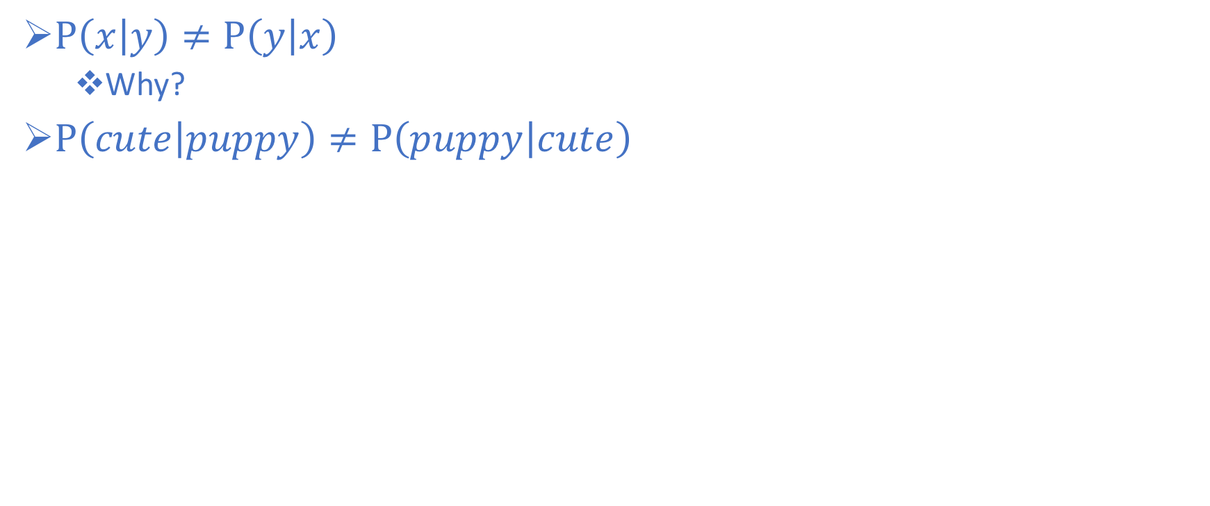
Conditional Probability – Order Matters
$P\left(x | y\right)≠P\left(y | x\right)$
Why?
$P\left(cute | puppy\right)≠P\left(puppy | cute\right)$

Slide 68
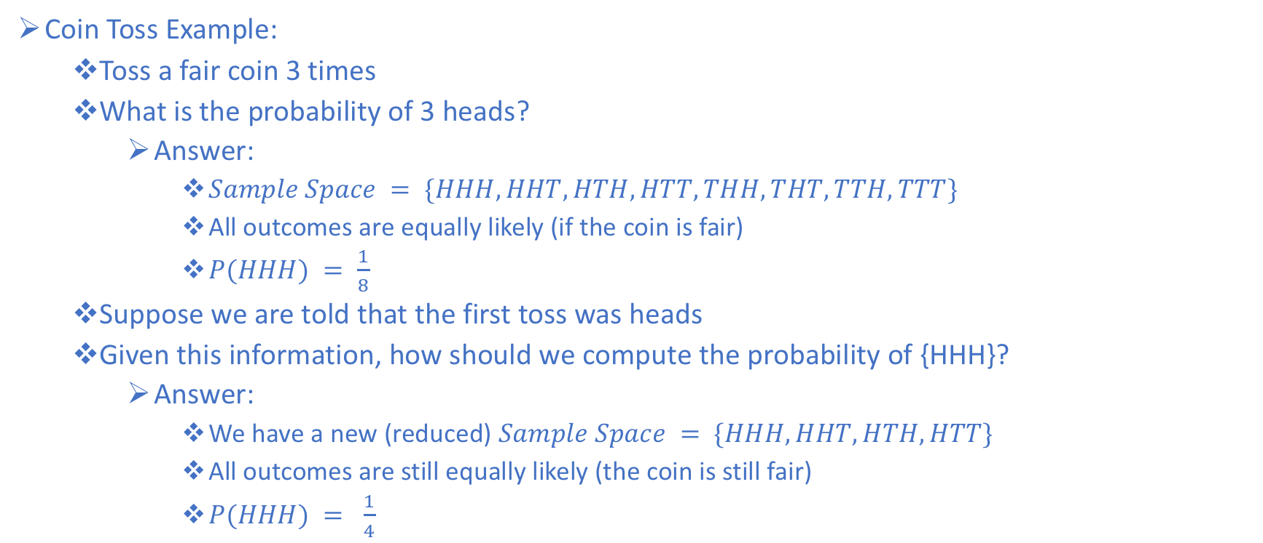
Conditional Probability Example
Coin Toss Example:
Toss a fair coin 3 times
What is the probability of 3 heads?
Answer:
$Sample Space = \{HHH, HHT, HTH, HTT, THH, THT, TTH, TTT\}$
All outcomes are equally likely (if the coin is fair)
$P(HHH) = \frac{1}{8}$
Suppose we are told that the first toss was heads
Given this information, how should we compute the probability of {HHH}?
Answer:
We have a new (reduced) $Sample Space = \{HHH, HHT, HTH, HTT\}$
All outcomes are still equally likely (the coin is still fair)
$P(HHH) = \frac{1}{4}$

Slide 69
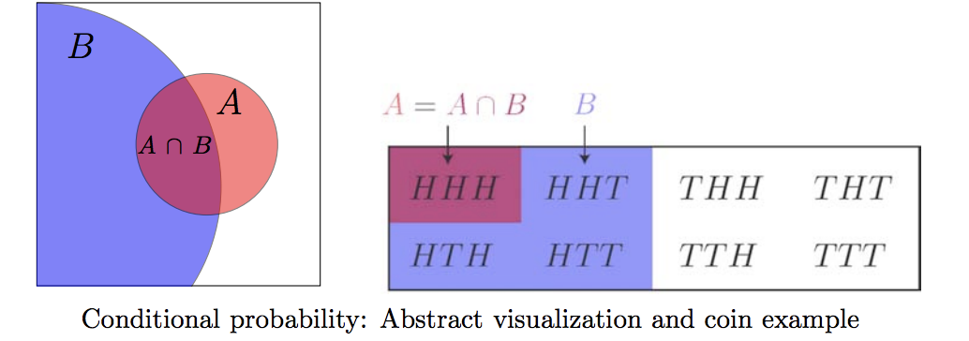
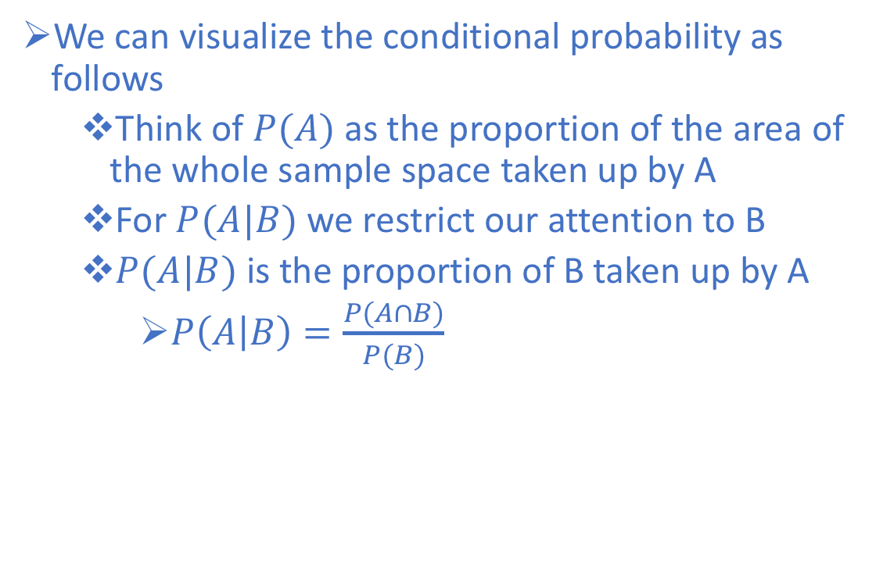
Conditional Probability Example
We can visualize the conditional probability as follows
Think of $P(A)$as the proportion of the area of the whole sample space taken up by A
For $P(A|B)$ we restrict our attention to B
$P(A|B)$ is the proportion of B taken up by A
$P\left(A | B\right)=\frac{P(A∩B)}{P(B)}$

Slide 70
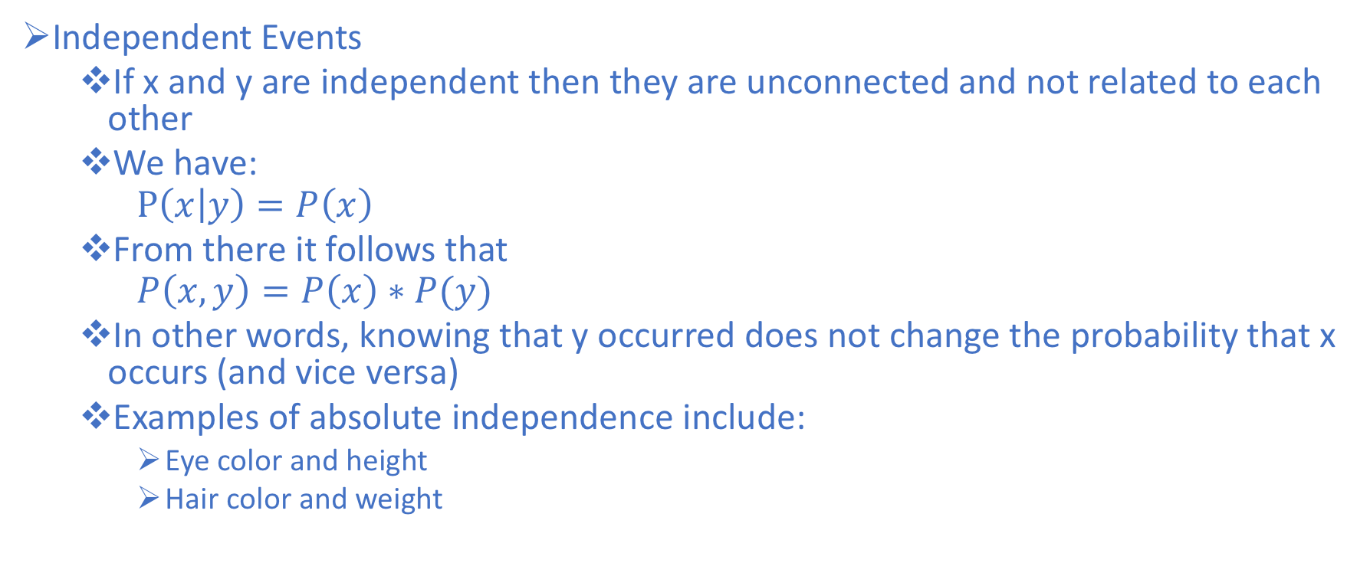
Statistical Independence
Independent Events
If x and y are independent then they are unconnected and not related to each other
We have:
$$P\left(x | y\right)=P\left(x\right)$$
From there it follows that
$$P\left(x,y\right)=P\left(x\right)∗P(y)$$
In other words, knowing that y occurred does not change the probability that x occurs (and vice versa)
Examples of absolute independence include:
Eye color and height
Hair color and weight

Slide 71
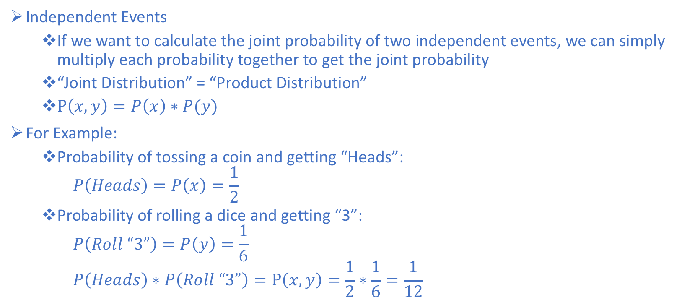
Statistical Independence Example
Independent Events
If we want to calculate the joint probability of two independent events, we can simply multiply each probability together to get the joint probability
“Joint Distribution” = “Product Distribution”
$P\left(x,y\right)=P\left(x\right)∗P(y)$
For Example:
Probability of tossing a coin and getting “Heads”:
$$P\left(Heads\right)=P\left(x\right)=\frac{1}{2}$$
Probability of rolling a dice and getting “3”:
$$P\left(Roll “3”\right)=P\left(y\right)=\frac{1}{6}$$
$$P\left(Heads\right)∗P\left(Roll “3”\right)=P\left(x,y\right)=\frac{1}{2}∗\frac{1}{6}=\frac{1}{12}$$

Slide 72
Bayesian Inference
The Naïve Bayes Classifier relies on three things:
Independence assumption
The notion of conditional probability
Bayesian Inference - a method of statistical inference in which Bayes Theorem is used to update the probability for a hypothesis as more evidence becomes available.

Slide 73
Bayesian Inference Example
We observe that the sidewalk is wet
What are the possible causes?

Slide 74
Bayesian Inference Example
We observe that the sidewalk is wet
What are the possible causes?
It rained recently
Sprinkler
Broken water main (pipe)
Person spilled a drink
Dog marked his territory

Slide 75
Bayesian Inference Example
Based on information that we have, we have some notion that certain probabilities are greater than others
For example:
P(recent rain) > P(sprinkler)
P(recent rain) > P(spilled drink)
Bayesian inference incorporates previous knowledge (prior probabilities)

Slide 76
Bayesian Inference Example
Observation A:
Suppose we observe that the sidewalk is wet, in addition to the grass, the trees, the street, and the parked cars
How do the probabilities change given this new information?

Slide 77
Bayesian Inference Example
Observation A:
Suppose we observe that the sidewalk is wet, in addition to the grass, the trees, the street, and the parked cars
How do the probabilities change given this new information?
P(recent rain | Observation A)

Slide 78
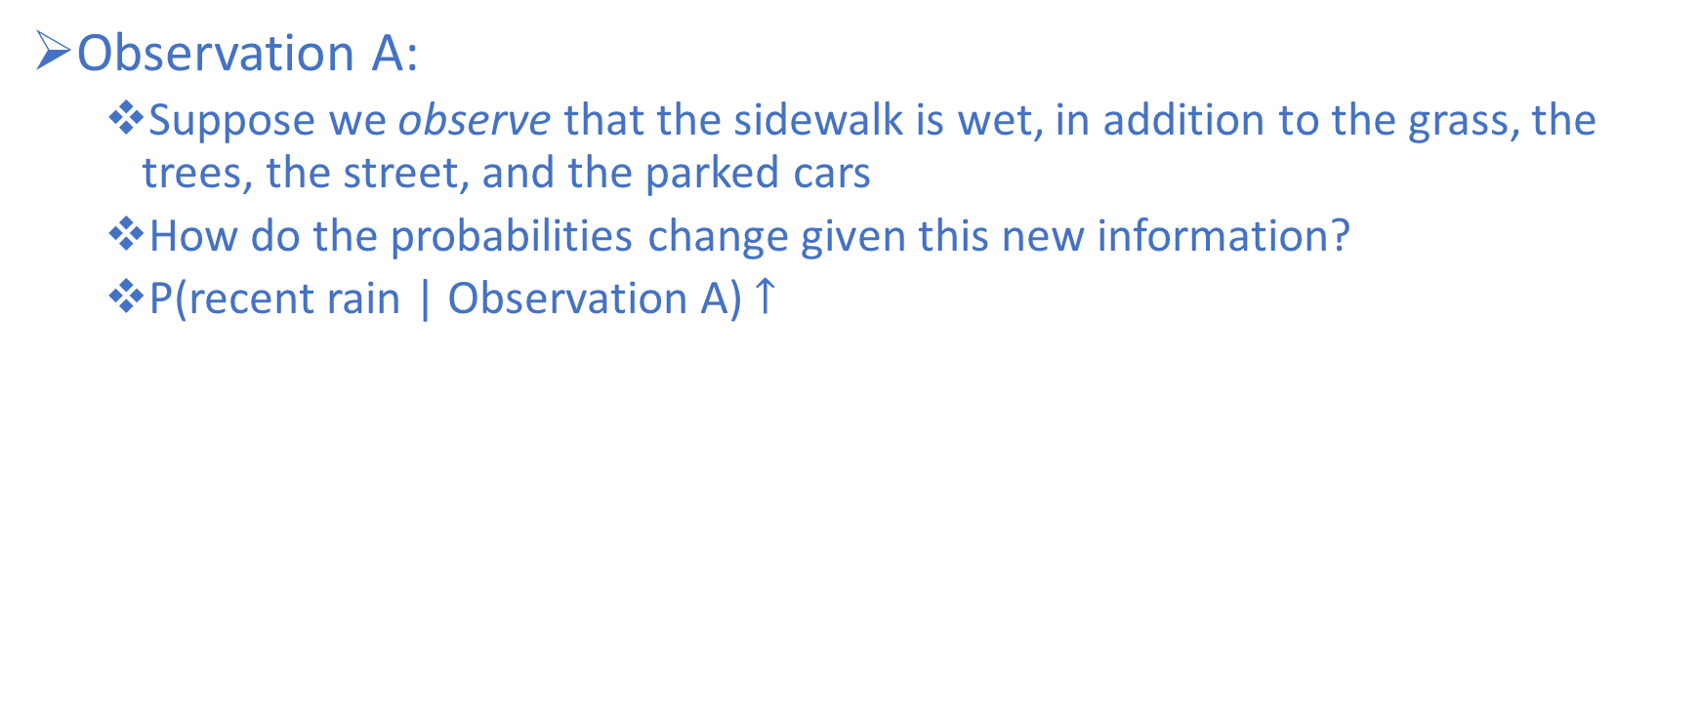
Bayesian Inference Example
Observation A:
Suppose we observe that the sidewalk is wet, in addition to the grass, the trees, the street, and the parked cars
How do the probabilities change given this new information?
P(recent rain | Observation A) $↑$

Slide 79
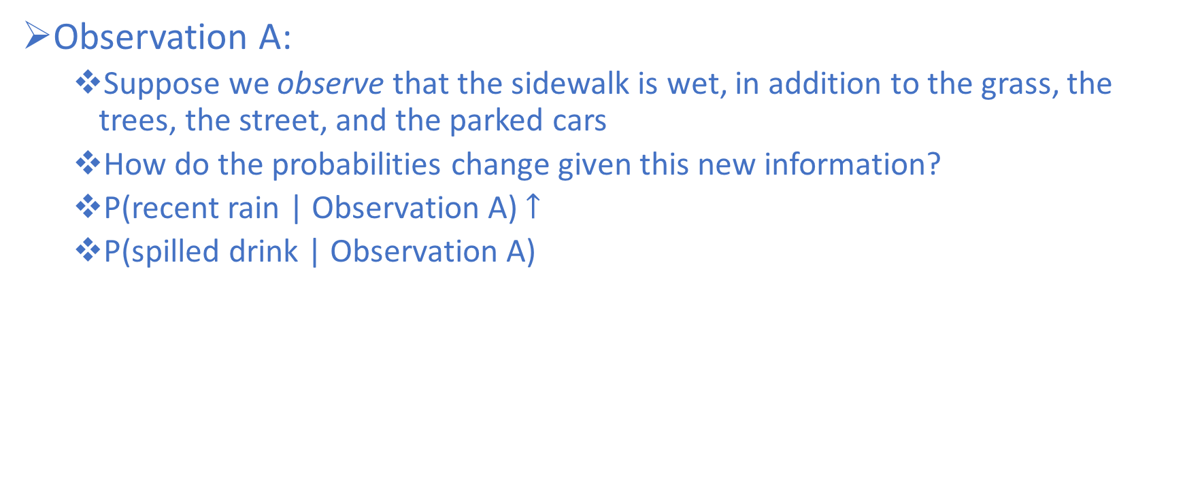
Bayesian Inference Example
Observation A:
Suppose we observe that the sidewalk is wet, in addition to the grass, the trees, the street, and the parked cars
How do the probabilities change given this new information?
P(recent rain | Observation A) $↑$
P(spilled drink | Observation A)

Slide 80
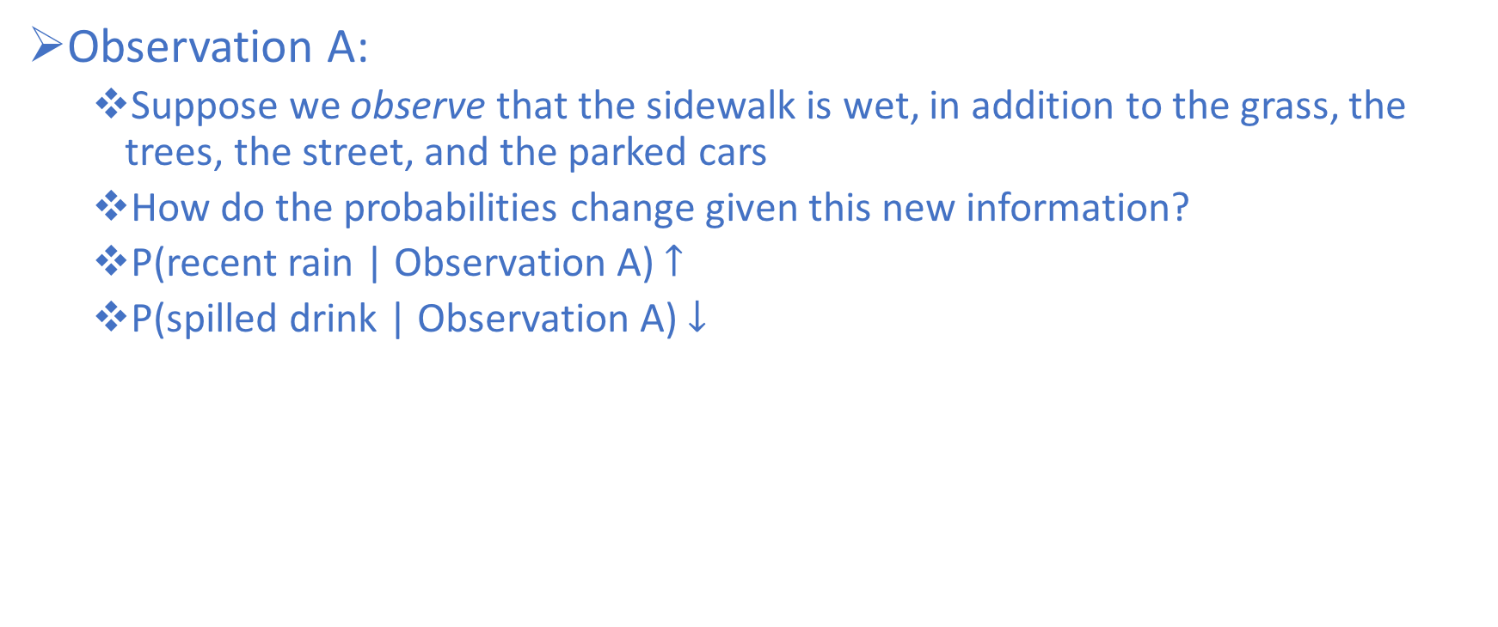
Bayesian Inference Example
Observation A:
Suppose we observe that the sidewalk is wet, in addition to the grass, the trees, the street, and the parked cars
How do the probabilities change given this new information?
P(recent rain | Observation A) $↑$
P(spilled drink | Observation A) $↓$

Slide 81
Bayesian Inference Example
Observation B:
Now suppose that instead we observe that the sidewalk is wet, but it is localized to a small area next to an empty water bottle
How do the probabilities change given this new information?

Slide 82
Bayesian Inference Example
Observation B:
Now suppose that instead we observe that the sidewalk is wet, but it is localized to a small area next to an empty water bottle
How do the probabilities change given this new information?
P(recent rain | Observation B)

Slide 83
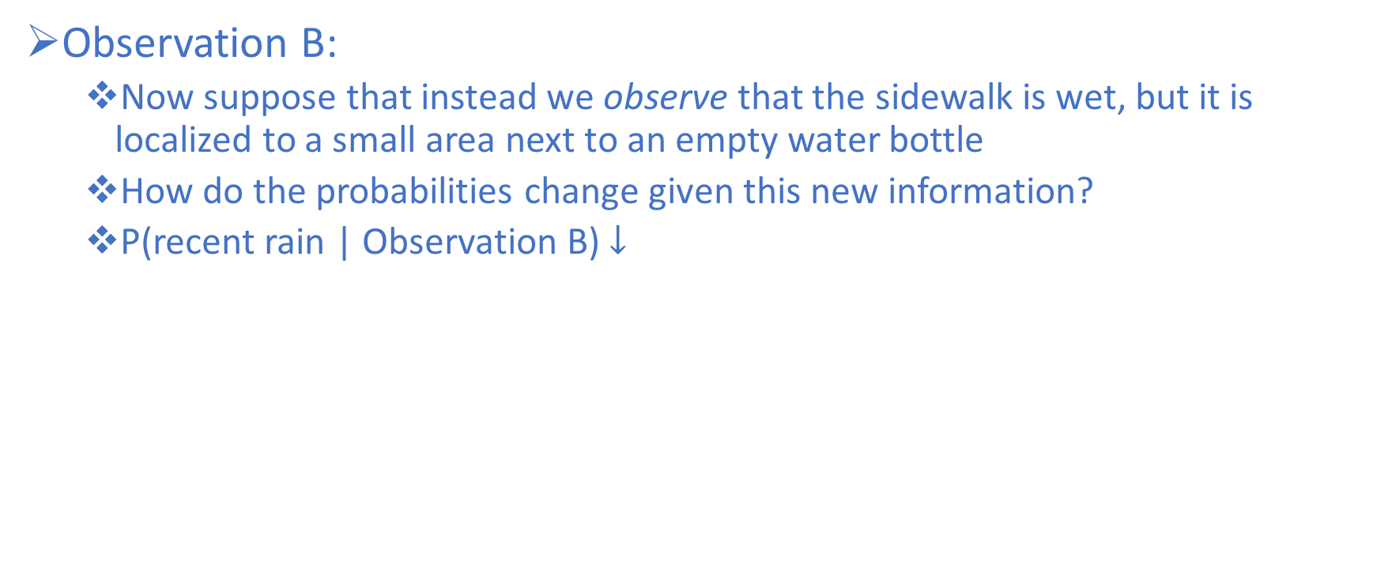
Bayesian Inference Example
Observation B:
Now suppose that instead we observe that the sidewalk is wet, but it is localized to a small area next to an empty water bottle
How do the probabilities change given this new information?
P(recent rain | Observation B) $↓$

Slide 84
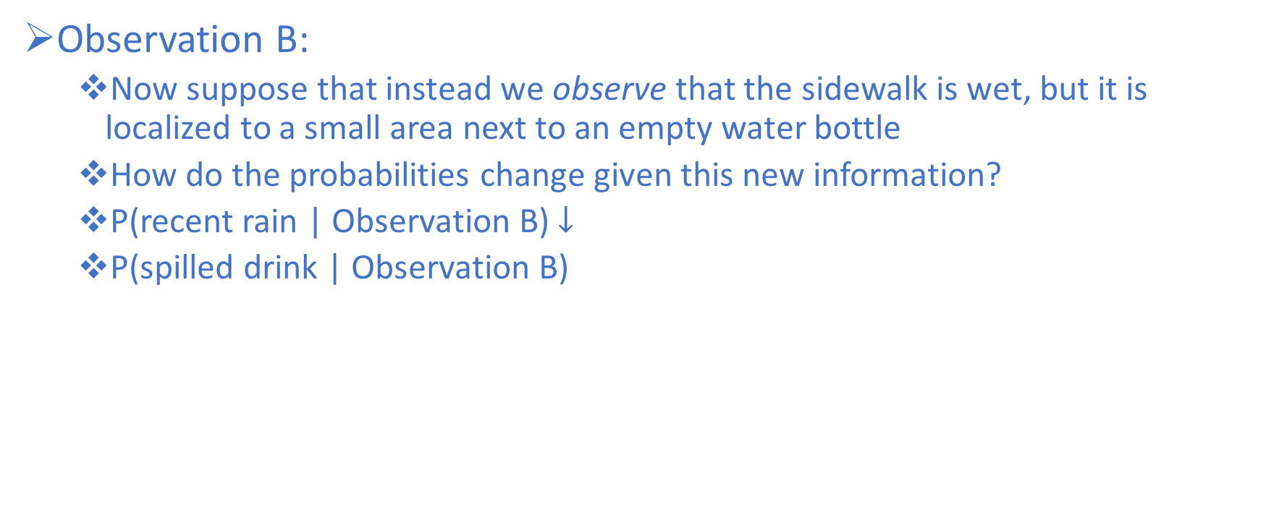
Bayesian Inference Example
Observation B:
Now suppose that instead we observe that the sidewalk is wet, but it is localized to a small area next to an empty water bottle
How do the probabilities change given this new information?
P(recent rain | Observation B) $↓$
P(spilled drink | Observation B)

Slide 85
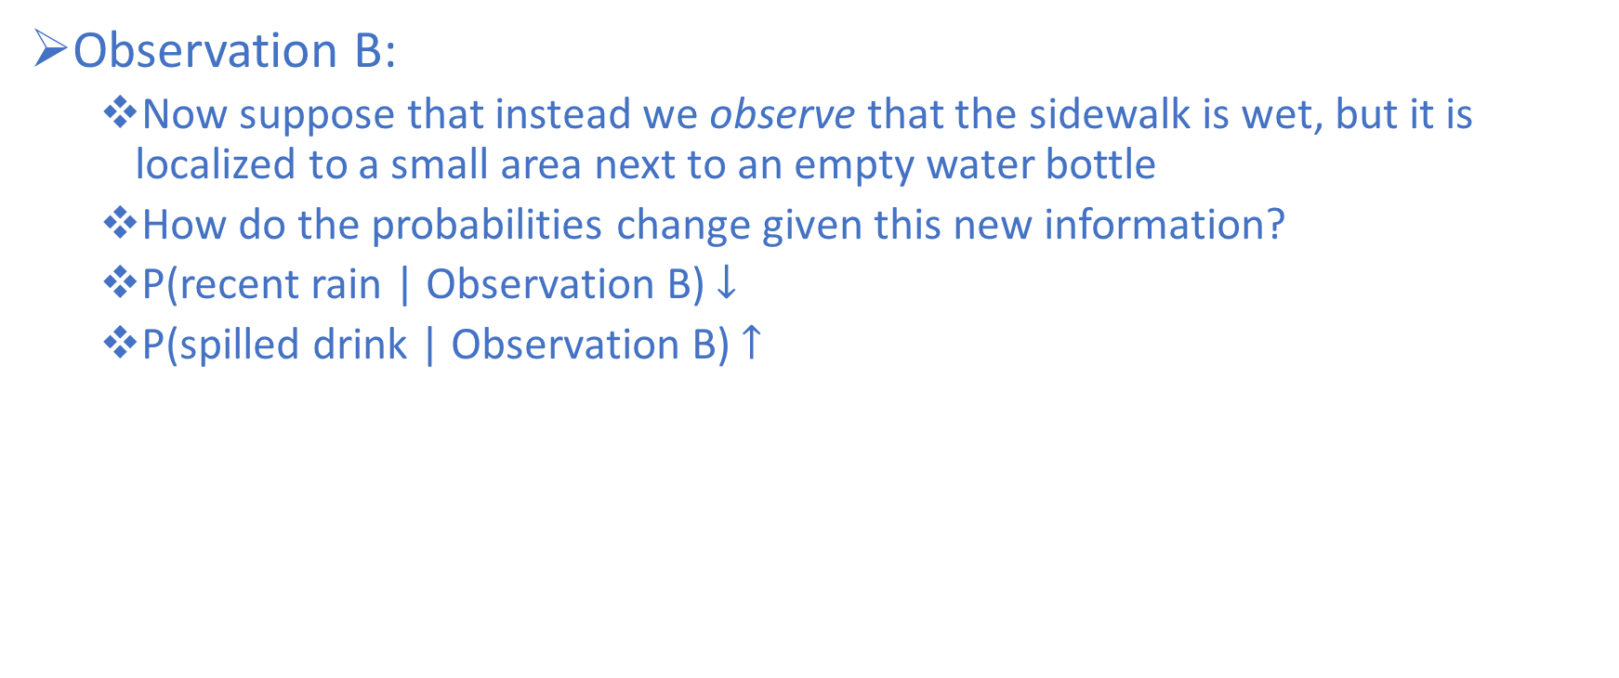
Bayesian Inference Example
Observation B:
Now suppose that instead we observe that the sidewalk is wet, but it is localized to a small area next to an empty water bottle
How do the probabilities change given this new information?
P(recent rain | Observation B) $↓$
P(spilled drink | Observation B) $↑$

Slide 86
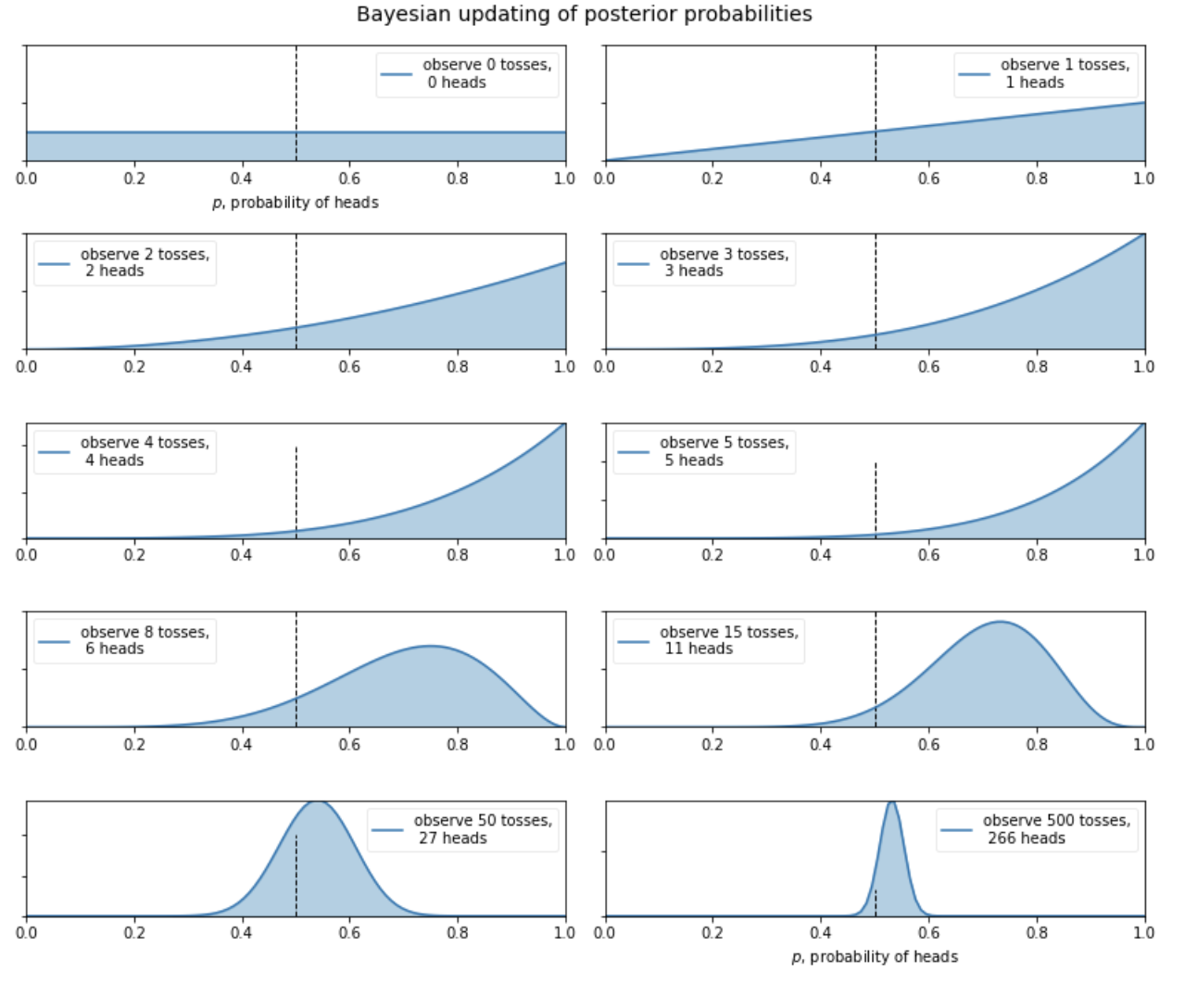
Bayesian Updating

Slide 87
Applying Bayesian Inference to parameters/data
Naïve Bayes is a machine learning method that can be used to predict the likelihood that an event will occur given evidence that is present in your data
The Naïve Bayes Classifier relies on Bayesian inference at its core
Makes two “Naïve” assumptions over attributes

Slide 88
Naïve Bayes Classifier Assumptions
Fundamental assumption:
Each feature makes an independent and equal contribution to the outcome
We assume that no pair of features are dependent on one another in any way (complete independence)
Temperature has nothing to do with humidity, and has no effect on whether or not it is windy
Each feature is given the same weight/importance
We assume that none of the attributes is irrelevant, and that they are all contributing equally to the outcome.

Slide 89
Naïve Bayes Classifier
To illustrate the inner workings of the Naïve Bayes Classifier, we will consider an example:
We have recorded weather features about the last 14 times that we played golf.
We also recorded the result of whether the conditions were favorable or not.
We will demonstrate how a Naïve Bayes Classifier can be used to determine whether or not the a specific set of weather conditions supports playing golf.

Slide 90
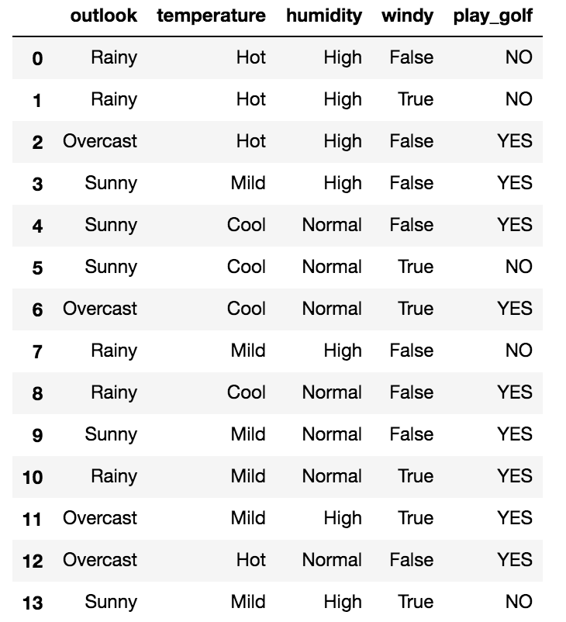
Naïve Bayes Classifier Example
Weather Independent Variables:
Outlook
(Rainy, Overcast, Sunny)
Temperature
(Hot, Mild, Cool)
Humidity
(High, Normal)
Windy
(False, True)
Weather Dependent Variable:
Play Golf
(YES, NO)

Slide 91
Naïve Bayes Classifier
How does the Naïve Bayes Classifier work?
Step 1:
Convert the data set into frequency tables
Use the frequency tables to calculate likelihood tables
Step 2:
Use the product rule to obtain a joint conditional probability for the attributes
Step 3:
Use Bayes Rule to calculate the posterior probability for each class variable
Once this has been done for all classes, output the class with the highest probability

Slide 92
Naïve Bayes Classifier Example
Step 1:
Create a frequency table for the Class:
P(C) or P(CLASS)
P(YES)

Slide 93
Naïve Bayes Classifier Example
Step 1:
Create a frequency table for the Class:
P(C) or P(CLASS)
P(YES) = 9/14

Slide 94
Naïve Bayes Classifier Example
Step 1:
Create a frequency table for the Class:
P(C) or P(CLASS)
P(YES) = 9/14
P(NO) = 5/14

Slide 95
Naïve Bayes Classifier Example
Step 1:
Create a frequency table for the Class:
P(C) or P(CLASS)
P(YES) = 9/14
P(NO) = 5/14
Class Frequency Table:
Play
YES | 9
NO | 5
Total | 14

Slide 96
Naïve Bayes Classifier
How does the Naïve Bayes Classifier work?
Step 1:
Convert the data set into frequency tables
Use the frequency tables to calculate likelihood tables
Step 2:
Use the product rule to obtain a joint conditional probability for the attributes
Step 3:
Use Bayes Rule to calculate the posterior probability for each class variable
Once this has been done for all classes, output the class with the highest probability

Slide 97
Naïve Bayes Classifier Example
Step 1:
P(C) or P(CLASS)
P(YES) = 9/14 = 0.643
P(NO) = 5/14 = 0.357
The Class Frequency Table can be used to create the Class Likelihood Table by dividing each class frequency by the total (relative probability)
Likelihood Table:
Play |  | P(YES)
YES | 9 | 9/14 = 0.643
NO | 5 | 5/14 = 0.357
Total | 14 | 14/14 = 100%

Slide 98
Naïve Bayes Classifier Example
The next step is to repeat this process for each weather feature and compute their corresponding Feature Frequency Tables
These Frequency tables can then be used to create Likelihood tables as previously demonstrated for each feature (weather condition) in our dataset

Slide 99
Naïve Bayes Classifier Example
Outlook Frequency and Likelihood
Outlook
 | YES | NO | P(YES) | P(NO)
Sunny | 2 | 3 | 2/9 = 0.222 | 3/5 = 0.6
Overcast | 4 | 0 | 4/9 = 0.444 | 0/5 = 0
Rainy | 3 | 2 | 3/9 = 0.33 | 2/5 = 0.4
Total | 9 | 5 | 9/9 = 1 | 5/5 = 1

Slide 100
Naïve Bayes Classifier Example
Temperature Frequency and Likelihood
Temperature
 | YES | NO | P(YES) | P(NO)
Hot | 2 | 2 | 2/9 = 0.22 | 2/5 = 0.4
Mild | 4 | 2 | 4/9 = 0.44 | 2/5 = 0.4
Cool | 3 | 1 | 3/9 = 0.33 | 1/5 = 0.2
Total | 9 | 5 | 9/9 = 1 | 5/5 = 1

Slide 101
Naïve Bayes Classifier Example
Humidity Frequency and Likelihood
Humidity
 | YES | NO | P(YES) | P(NO)
High | 3 | 4 | 3/9 = 0.33 | 4/5 = 0.8
Normal | 6 | 1 | 6/9 = 0.66 | 1/5 = 0.2
Total | 9 | 5 | 9/9 = 1 | 5/5 = 1

Slide 102
Naïve Bayes Classifier Example
Windy Frequency and Likelihood
Windy
 | YES | NO | P(YES) | P(NO)
FALSE | 6 | 2 | 6/9 = 0.66 | 2/5 = 0.4
TRUE | 3 | 3 | 3/9 = 0.33 | 3/5 = 0.6
Total | 9 | 5 | 9/9 = 1 | 5/5 = 1

Slide 103
Bayes Rule applied to data
Bayes rule is merely the mathematical relation between the prior allocations of credibility and the posterior reallocation of credibility (conditional on data)
$$\text{P}\left(\text{C} | \text{X}\right)\text{= }\frac{\text{P}\left(\text{X} | \text{C}\right)\text{∗}\text{P}\text{(}\text{C}\text{)}}{\text{P}\text{(}\text{X}\text{)}}$$

Slide 104
Bayes Rule Explained
Posterior Probability of class (C) given predictor (X)
$$\text{P}\left(\text{C} | \text{X}\right)\text{= }\frac{\text{P}\left(\text{X} | \text{C}\right)\text{∗}\text{P}\text{(}\text{C}\text{)}}{\text{P}\text{(}\text{X}\text{)}}$$

Slide 105
Bayes Rule Explained
Posterior Probability of class (C) given predictor (X)
$$\text{P}\left(\text{C} | \text{X}\right)\text{= }\frac{\text{P}\left(\text{X} | \text{C}\right)\text{∗}\text{P}\text{(}\text{C}\text{)}}{\text{P}\text{(}\text{X}\text{)}}$$
This represents the probability of C being true, provided X is true

Slide 106
Bayes Rule Explained
$$\text{P}\left(\text{C} | \text{X}\right)\text{= }\frac{\text{P}\left(\text{X} | \text{C}\right)\text{∗}\text{P}\text{(}\text{C}\text{)}}{\text{P}\text{(}\text{X}\text{)}}$$
Likelihood - the conditional probability of the predictor-given the class

Slide 107
Bayes Rule Explained
$$\text{P}\left(\text{C} | \text{X}\right)\text{= }\frac{\text{P}\left(\text{X} | \text{C}\right)\text{∗}\text{P}\text{(}\text{C}\text{)}}{\text{P}\text{(}\text{X}\text{)}}$$
Likelihood - the conditional probability of the predictor-given the class
This represents the probability of X being true provided C is true

Slide 108
Bayes Rule Explained
$$\text{P}\left(\text{C} | \text{X}\right)\text{= }\frac{\text{P}\left(\text{X} | \text{C}\right)\text{∗}\text{P}\text{(}\text{C}\text{)}}{\text{P}\text{(}\text{X}\text{)}}$$
Prior Probability of the Class

Slide 109
Bayes Rule Explained
$$\text{P}\left(\text{C} | \text{X}\right)\text{= }\frac{\text{P}\left(\text{X} | \text{C}\right)\text{∗}\text{P}\text{(}\text{C}\text{)}}{\text{P}\text{(}\text{X}\text{)}}$$
Prior Probability of the Class
This represents the observed probability of the class out of all the observations

Slide 110
Bayes Rule Explained
$$\text{P}\left(\text{C} | \text{X}\right)\text{= }\frac{\text{P}\left(\text{X} | \text{C}\right)\text{∗}\text{P}\text{(}\text{C}\text{)}}{\text{P}\text{(}\text{X}\text{)}}$$
Prior Probability of the Predictor

Slide 111
Bayes Rule Explained
$$\text{P}\left(\text{C} | \text{X}\right)\text{= }\frac{\text{P}\left(\text{X} | \text{C}\right)\text{∗}\text{P}\text{(}\text{C}\text{)}}{\text{P}\text{(}\text{X}\text{)}}$$
Prior Probability of the Predictor
This represents the observed probability of the predictor out of all the observations

Slide 112
Naïve Bayes Classifier
How does the Naïve Bayes Classifier work?
Step 1:
Convert the data set into frequency tables
Use the frequency tables to calculate likelihood tables
Step 2:
Use the product rule to obtain a joint conditional probability for the attributes
Step 3:
Use Bayes Rule to calculate the posterior probability for each class variable
Once this has been done for all classes, output the class with the highest probability

Slide 113
Bayes Rule Explained
Prior Probability of the Predictor can be estimated directly by multiplying the individual relative frequencies of each predictor due to the naive independence assumption
$$\text{P}\left(\text{C} | \text{X}\right)\text{= }\frac{\text{P}\left(\text{X} | \text{C}\right)\text{∗}\text{P}\text{(}\text{C}\text{)}}{\text{P}\text{(}\text{X}\text{)}}$$

Slide 114
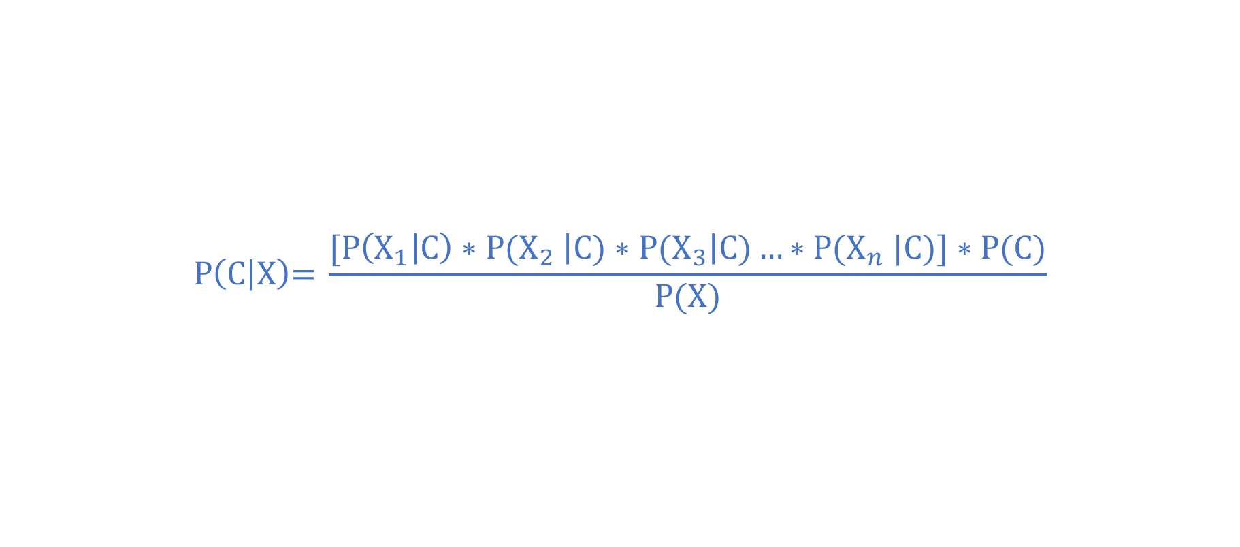
Bayes Rule Explained
Key Idea: the “naive assumption“ allows us to multiply the probabilities
Prior Probability of the Predictor can be estimated directly by multiplying the individual relative frequencies of each predictor (due to the naive independence assumption)
$$\text{P}\left(\text{C} | \text{X}\right)\text{= }\frac{\text{[}\text{P}\left({\text{X}}_{1} | \text{C}\right){∗\text{P}\text{(}\text{X}}_{2}\left|\text{C}\text{)}{∗\text{P}\text{(}\text{X}}_{3}\right|\text{C}\text{)}…{∗\text{P}\text{(}\text{X}}_{n}|\text{C}\text{)]}∗\text{P}\text{(}\text{C}\text{)}}{\text{P}\text{(}\text{X}\text{)}}$$

Slide 115
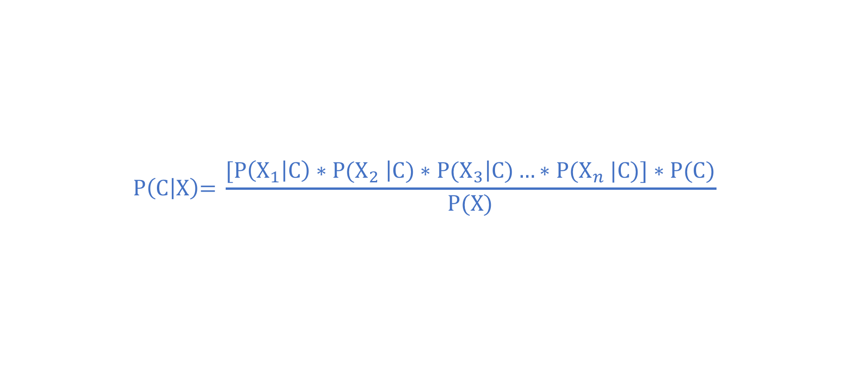
Naïve Bayes Classifier Example
Lets consider the following case, and try to predict whether we should golf or not
$$\text{P}\left(\text{C} | \text{X}\right)\text{= }\frac{\text{[}\text{P}\left({\text{X}}_{1} | \text{C}\right){∗\text{P}\text{(}\text{X}}_{2}\left|\text{C}\text{)}{∗\text{P}\text{(}\text{X}}_{3}\right|\text{C}\text{)}…{∗\text{P}\text{(}\text{X}}_{n}|\text{C}\text{)]}∗\text{P}\text{(}\text{C}\text{)}}{\text{P}\text{(}\text{X}\text{)}}$$
Outlook | Temperature | Humidity | Windy? | Play?
Sunny | Cool | High | TRUE | YES

Slide 116
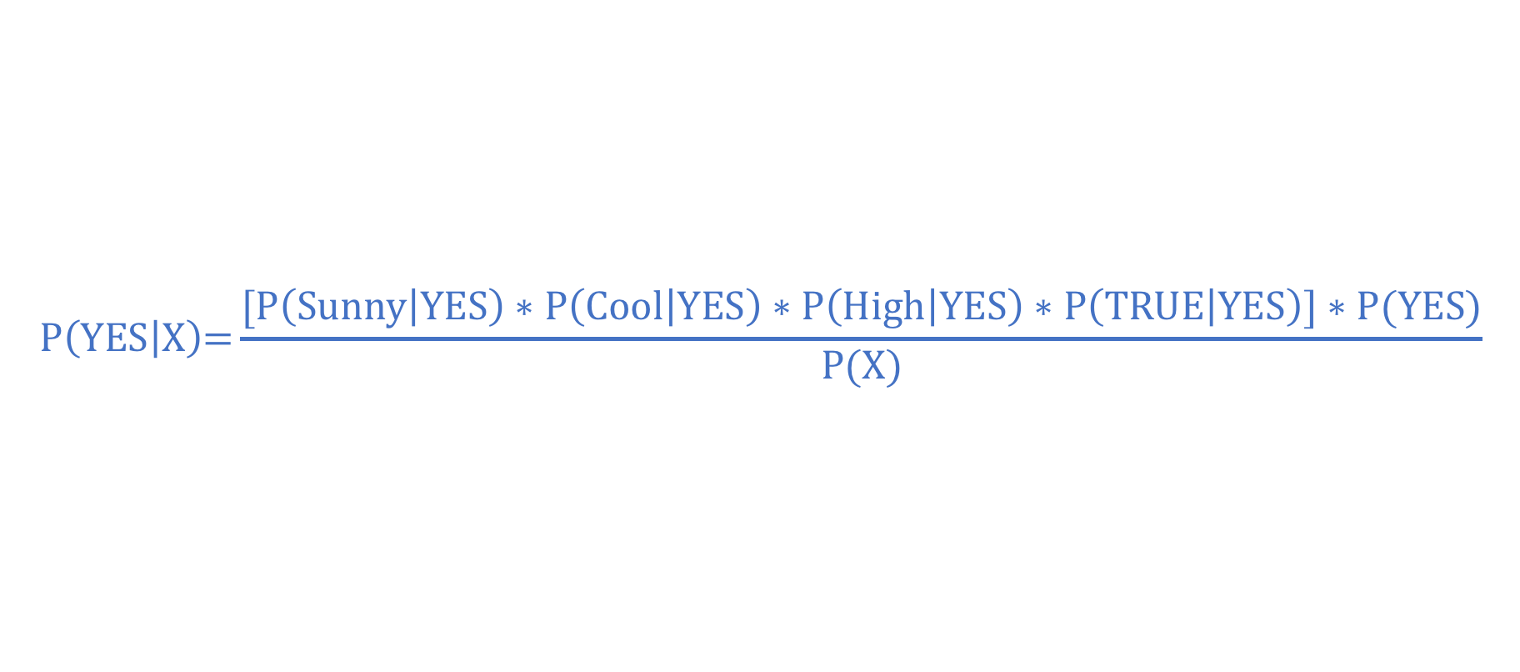
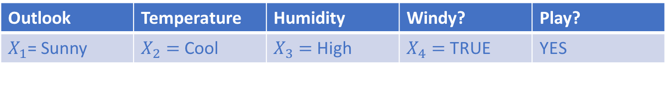
Naïve Bayes Classifier Example
Lets consider the following case, and try to predict whether we should golf or not
$$\text{P}\left(\text{YES} | \text{X}\right)\text{=}\frac{\text{[}\text{P}\left(\text{Sunny} | \text{YES}\right)∗\text{P}\left(\text{Cool} | \text{YES}\right)∗\text{P}\left(\text{High} | \text{YES}\right)∗\text{P}\left(\text{TRUE} | \text{YES}\right)\text{]}∗\text{P}\text{(}\text{YES}\text{)}}{\text{P}\text{(}\text{X}\text{)}}$$
Outlook | Temperature | Humidity | Windy? | Play?
$X_{1}$= Sunny | $X_{2}=$Cool | $X_{3}=$High | $X_{4}=$TRUE | YES

Slide 117
Naïve Bayes Classifier Example
Outlook | Temperature | Humidity | Windy? | Play?
Sunny | Cool | High | TRUE | YES
Outlook = Sunny
P(Sunny|YES)=0.22
P(Sunny|NO)=0.6
Outlook
 | YES | NO | P(YES) | P(NO)
Sunny | 2 | 3 | 2/9 = 0.222 | 3/5 = 0.6
Overcast | 4 | 0 | 4/9 = 0.444 | 0/5 = 0
Rainy | 3 | 2 | 3/9 = 0.33 | 2/5 = 0.4
Total | 9 | 5 | 9/9 = 1 | 5/5 = 1

Slide 118
Naïve Bayes Classifier Example
Outlook | Temperature | Humidity | Windy? | Play?
Sunny | Cool | High | TRUE | YES
Temperature = Cool
P(Cool|YES) = 0.33
P(Cool|NO) = 0.2
Temperature
 | YES | NO | P(YES) | P(NO)
Hot | 2 | 2 | 2/9 = 0.22 | 2/5 = 0.4
Mild | 4 | 2 | 4/9 = 0.44 | 2/5 = 0.4
Cool | 3 | 1 | 3/9 = 0.33 | 1/5 = 0.2
Total | 9 | 5 | 9/9 = 1 | 5/5 = 1

Slide 119
Naïve Bayes Classifier Example
Outlook | Temperature | Humidity | Windy? | Play?
Sunny | Cool | High | TRUE | YES
Humidity = High
P(High|YES) = 0.33
P(High|NO) = 0.8
Humidity
 | YES | NO | P(YES) | P(NO)
High | 3 | 4 | 3/9 = 0.33 | 4/5 = 0.8
Normal | 6 | 1 | 6/9 = 0.66 | 1/5 = 0.2
Total | 9 | 5 | 9/9 = 1 | 5/5 = 1

Slide 120
Naïve Bayes Classifier Example
Outlook | Temperature | Humidity | Windy? | Play?
Sunny | Cool | High | TRUE | YES
Windy = True
P(TRUE|YES) = 0.33
P(TRUE|NO) = 0.6
Windy
 | YES | NO | P(YES) | P(NO)
FALSE | 6 | 2 | 6/9 = 0.66 | 2/5 = 0.4
TRUE | 3 | 3 | 3/9 = 0.33 | 3/5 = 0.6
Total | 9 | 5 | 9/9 = 1 | 5/5 = 1

Slide 121
Naïve Bayes Classifier Example
Outlook | Temperature | Humidity | Windy? | Play?
Sunny | Cool | High | TRUE | YES
Play = YES
P(C) = P(YES) = 0.64
P(C) = P(NO) = 0.36
Play |  | P(YES)
YES | 9 | 9/14 = 0.64
NO | 5 | 5/14 = 0.36
Total | 14 | 14/14 = 100%

Slide 122
Naïve Bayes Classifier
How does the Naïve Bayes Classifier work?
Step 1:
Convert the data set into frequency tables
Use the frequency tables to calculate likelihood tables
Step 2:
Use the product rule to obtain a joint conditional probability for the attributes
Step 3:
Use Bayes Rule to calculate the posterior probability for each class variable
Once this has been done for all classes, output the class with the highest probability

Slide 123
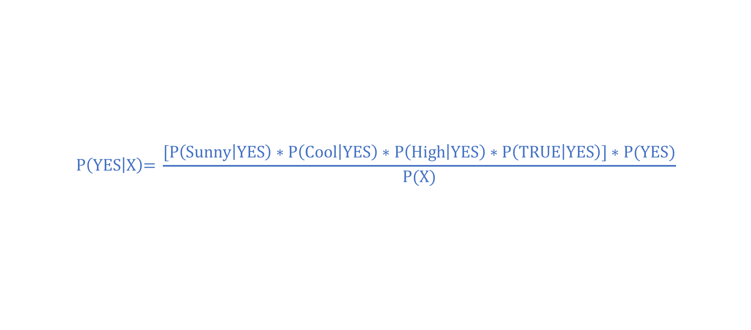
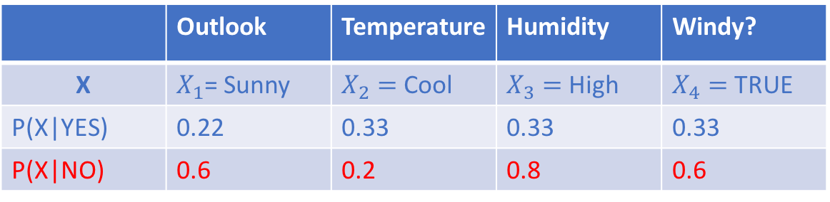
Naïve Bayes Classifier Example
Lets consider the following case, and try to predict whether we can golf or not
$$\text{P}\left(\text{YES} | \text{X}\right)\text{= }\frac{\text{[}\text{P}\left(\text{Sunny} | \text{YES}\right)∗\text{P}\left(\text{Cool} | \text{YES}\right)∗\text{P}\left(\text{High} | \text{YES}\right)∗\text{P}\left(\text{TRUE} | \text{YES}\right)\text{]}∗\text{P}\text{(}\text{YES}\text{)}}{\text{P}\text{(}\text{X}\text{)}}$$
 | Outlook | Temperature | Humidity | Windy?
X | $X_{1}$= Sunny | $X_{2}=$Cool | $X_{3}=$High | $X_{4}=$TRUE
P(X|YES) | 0.22 | 0.33 | 0.33 | 0.33
P(X|NO) | 0.6 | 0.2 | 0.8 | 0.6
 | Play?
C | YES
P(YES) | 0.64
P(NO) | 0.36

Slide 124

Naïve Bayes Classifier Example
Lets consider the following case, and try to predict whether we can golf or not
$$\text{P}\left(\text{YES} | \text{X}\right)\text{= }\frac{\text{[}0.22∗0.33∗0.33∗0.33\text{]}∗\text{0.64}}{\text{P}\text{(}\text{X}\text{)}}$$
 | Outlook | Temperature | Humidity | Windy?
X | $X_{1}$= Sunny | $X_{2}=$Cool | $X_{3}=$High | $X_{4}=$TRUE
P(X|YES) | 0.22 | 0.33 | 0.33 | 0.33
P(X|NO) | 0.6 | 0.2 | 0.8 | 0.6
 | Play?
C | YES
P(YES) | 0.64
P(NO) | 0.36

Slide 125

Naïve Bayes Classifier Example
Lets consider the following case, and try to predict whether we can golf or not
$$\text{P}\left(\text{YES} | \text{X}\right)\text{= }\frac{\text{0}.0053}{\text{P}\text{(}\text{X}\text{)}}$$
 | Outlook | Temperature | Humidity | Windy?
X | $X_{1}$= Sunny | $X_{2}=$Cool | $X_{3}=$High | $X_{4}=$TRUE
P(X|YES) | 0.22 | 0.33 | 0.33 | 0.33
P(X|NO) | 0.6 | 0.2 | 0.8 | 0.6
 | Play?
C | YES
P(YES) | 0.64
P(NO) | 0.36

Slide 126

Naïve Bayes Classifier Example
Lets consider the following case, and try to predict whether we can golf or not
$$\text{P}\left(\text{NO} | \text{X}\right)\text{= }\frac{\text{[}\text{P}\left(\text{Sunny} | \text{NO}\right)∗\text{P}\left(\text{Cool} | \text{NO}\right)∗\text{P}\left(\text{High} | \text{NO}\right)∗\text{P}\left(\text{TRUE} | \text{NO}\right)\text{]}∗\text{P}\text{(}\text{NO}\text{)}}{\text{P}\text{(}\text{X}\text{)}}$$
 | Outlook | Temperature | Humidity | Windy?
X | $X_{1}$= Sunny | $X_{2}=$Cool | $X_{3}=$High | $X_{4}=$TRUE
P(X|YES) | 0.22 | 0.33 | 0.33 | 0.33
P(X|NO) | 0.6 | 0.2 | 0.8 | 0.6
 | Play?
C | YES
P(YES) | 0.64
P(NO) | 0.36

Slide 127

Naïve Bayes Classifier Example
Lets consider the following case, and try to predict whether we can golf or not
$$P\left(NO | X\right)= \frac{[0.6∗0.2∗0.8∗0.6]∗0.36}{P(X)}$$
 | Outlook | Temperature | Humidity | Windy?
X | $X_{1}$= Sunny | $X_{2}=$Cool | $X_{3}=$High | $X_{4}=$TRUE
P(X|YES) | 0.22 | 0.33 | 0.33 | 0.33
P(X|NO) | 0.6 | 0.2 | 0.8 | 0.6
 | Play?
C | YES
P(YES) | 0.64
P(NO) | 0.36

Slide 128

Naïve Bayes Classifier Example
Lets consider the following case, and try to predict whether we can golf or not
$$P\left(NO | X\right)= \frac{0.0206}{P(X)}$$
 | Outlook | Temperature | Humidity | Windy?
X | $X_{1}$= Sunny | $X_{2}=$Cool | $X_{3}=$High | $X_{4}=$TRUE
P(X|YES) | 0.22 | 0.33 | 0.33 | 0.33
P(X|NO) | 0.6 | 0.2 | 0.8 | 0.6
 | Play?
C | YES
P(YES) | 0.64
P(NO) | 0.36

Slide 129


Naïve Bayes Classifier Example
Lets consider the following case, and try to predict whether we can golf or not
 | Outlook | Temperature | Humidity | Windy?
X | $X_{1}$= Sunny | $X_{2}=$Cool | $X_{3}=$High | $X_{4}=$TRUE
P(X|YES) | 0.22 | 0.33 | 0.33 | 0.33
P(X|NO) | 0.6 | 0.2 | 0.8 | 0.6
 | Play?
C | YES
P(YES) | 0.64
P(NO) | 0.36
Likelihood of playing golf under these conditions:
$$\text{P}\left(\text{YES} | \text{X}\right)\text{= }\frac{\text{0}.0053}{\text{P}\text{(}\text{X}\text{)}}$$
Likelihood of NOT playing golf under these conditions:
$$\text{P}\left(\text{NO} | \text{X}\right)\text{= }\frac{\text{0}.0206}{\text{P}\text{(}\text{X}\text{)}}$$

Slide 130


Naïve Bayes Classifier Example
Lets consider the following case, and try to predict whether we can golf or not
 | Outlook | Temperature | Humidity | Windy?
X | $X_{1}$= Sunny | $X_{2}=$Cool | $X_{3}=$High | $X_{4}=$TRUE
P(X|YES) | 0.22 | 0.33 | 0.33 | 0.33
P(X|NO) | 0.6 | 0.2 | 0.8 | 0.6
 | Play?
C | YES
P(YES) | 0.64
P(NO) | 0.36
Likelihood of playing golf under these conditions:
$$\text{P}\left(\text{YES} | \text{X}\right)\text{= }\frac{\text{0}.0053}{\text{P}\text{(}\text{X}\text{)}}$$
Probability of Play = YES:
$\text{P}\left(\text{YES} | \text{X}\right)\text{= }\frac{\text{0.0053}}{\text{(0.0053 + }\text{0.0206}\text{)}}=$20.5%
Likelihood of NOT playing golf under these conditions:
$$\text{P}\left(\text{NO} | \text{X}\right)\text{= }\frac{\text{0}.0206}{\text{P}\text{(}\text{X}\text{)}}$$
Probability of Play = NO:
$\text{P}\left(\text{NO} | \text{X}\right)\text{= }\frac{\text{0.0206}}{\text{(}\text{0.0053}\text{ + }\text{0}\text{.0206)}}=79$.5%

Slide 131

Naïve Bayes Classifier Example
Lets consider the following case, and try to predict whether we can golf or not
 | Outlook | Temperature | Humidity | Windy?
X | $X_{1}$= Sunny | $X_{2}=$Cool | $X_{3}=$High | $X_{4}=$TRUE
P(X|YES) | 0.22 | 0.33 | 0.33 | 0.33
P(X|NO) | 0.6 | 0.2 | 0.8 | 0.6
 | Play?
C | YES
P(YES) | 0.64
P(NO) | 0.36
Likelihood of playing golf under these conditions:
$$\text{P}\left(\text{YES} | \text{X}\right)\text{= }\frac{\text{0}.0053}{\text{P}\text{(}\text{X}\text{)}}$$
Probability of Play = YES:
$\text{P}\left(\text{YES} | \text{X}\right)\text{= }\frac{\text{0.0053}}{\text{(0.0053 + }\text{0.0206}\text{)}}=$20.5%
Likelihood of NOT playing golf under these conditions:
$$\text{P}\left(\text{NO} | \text{X}\right)\text{= }\frac{\text{0}.0206}{\text{P}\text{(}\text{X}\text{)}}$$
Probability of Play = NO:
$\text{P}\left(\text{NO} | \text{X}\right)\text{= }\frac{\text{0.0206}}{\text{(}\text{0.0053}\text{ + }\text{0}\text{.0206)}}=79$.5%

Slide 132
Naïve Bayes Classifier Results
Probability of Play = YES
0.0053/(0.0053 + 0.0206) = 20.5%
Probability of Play = NO
0.0206 / (0.0053 + 0.0206) = 79.5%

Slide 133
Naïve Bayes Classifier Results
The Naïve Bayes Classifier predicts that we should not play golf under the conditions in question
Outlook | Temperature | Humidity | Windy? | Play?
Sunny | Cool | High | TRUE | YES

Slide 134
Naïve Bayes Exercise

Slide 135
Properties of Bayes Classifiers
Incrementality:
With each training example, the prior and the likelihood can be updated dynamically (Flexible)
Combines prior knowledge and observed data:
Prior probability of a hypothesis multiplied with the probability of the hypothesis given the training data
Probabilistic hypotheses:
Outputs not only a classification, but a probability distribution over all classes
Performs well with multi-class prediction
Meta-classification:
The outputs of several classifiers can easily be combined (ensembled)
E.g. by multiplying the probabilities that all classifiers predict for a given class

Slide 136
Improving Naïve Bayes
If continuous features do not have normal distribution, we should use transformation or different methods to convert it in normal distribution.
If test data set has zero frequency issue, apply smoothing techniques “Laplace Correction” to predict the class of test data set
Remove correlated features, as the highly correlated features are voted twice in the model and it can lead to over inflating importance
Not about tuning parameters
Naive Bayes classifiers have few parameters to tune
Preprocessing is more effective

Slide 137
Logistic Regression

Slide 138
Logistic Regression
When we think of linear regression, we usually think of predicting a numeric quantity
Logistic Regression is somewhat misleading in that it serves primarily as a binary classification model
Categorical response (y) with 2 levels (binary: 0 and 1)
Passing or failing a test
Surviving a plane crash or not
Hospitalisation required or not
Diagnosis of diabetes (yes / no)
Labelling (over/under some threshold)
Predictor variables (x_{i}) can take on any form: binary, categorical, and/or continuous

Slide 139
Logistic Regression Classification
Consider this set of binary data
y
1
0
x

Slide 140
Logistic Regression Classification
Consider this set of binary data
y
1
Passed Exam?
0
x
Hours of Studying

Slide 141
Logistic Regression Classification
Consider this set of binary data
y
1
I could have still passed here
This is usually me
Passed Exam?
0
x
Hours of Studying

Slide 142
Logistic Regression Classification
Consider this set of binary data
y
1
My Roommate in College
Passed Exam?
0
x
We all feel bad for this guy
Hours of Studying

Slide 143
Logistic Regression Classification
Linear Model? – Aside from being binary, there’s nothing special about (y)
y
1
Passed Exam?
0
x
Hours of Studying

Slide 144
Logistic Regression Classification
The value of “Passed Exam” is higher if a student studies more
y
1
Passed Exam?
0
x
Hours of Studying

Slide 145


Logistic Regression Classification
Linear Model
$Pass= β_{0}+β_{1}hours of studying+ ε$
Problem
We want to see what makes the dependent variable change from a 0 to a 1
This can also be interpreted as what increases the likelihood of passing, or $P(pass=1)$which we can simply denote as $p$.
We should then be able to re-write the linear model as
$P\left(pass=1\right)=p=β_{0}+β_{1}hours of studying+ ε$
Every additional hour of studying increases the probability of passing by $x\%$

Slide 146

Logistic Regression Classification
$$P\left(pass=1\right)=β_{0}+β_{1}hours of studying+ ε$$
Recall
Probabilities are bounded by $0≤p≤1$
If we were to look at students who studied this many hours, our model would predict a probability greater than 1

Slide 147

Logistic Regression Classification
$$P\left(pass=1\right)=β_{0}+β_{1}hours of studying+ ε$$
Recall
Probabilities are bounded by $0≤p≤1$
If we were to look at students who studied this many hours, our model would predict a probability greater than 1
Likewise, here our model would predict a probability less than 0

Slide 148

Logistic Regression Classification
$$P\left(pass=1\right)=β_{0}+β_{1}hours of studying+ ε$$
Recall
Probabilities are bounded by $0≤p≤1$
If we were to look at students who studied this many hours, our model would predict a probability greater than 1
Likewise, here our model would predict a probability less than 0
In addition to violating the laws of probability, our model would not maintain normally distributed residuals (which is another requirement of a linear regression model)

Slide 149

Logistic Regression Classification
$$P\left(pass=1\right)=β_{0}+β_{1}hours of studying+ ε$$
Recall
Probabilities are bounded by $0≤p≤1$
If we were to look at students who studied this many hours, our model would predict a probability greater than 1
Likewise, here our model would predict a probability less than 0
In addition to violating the laws of probability, our model would not maintain normally distributed residuals (which is another requirement of a linear regression model)
What can we do to fix this?

Slide 150
Logistic Regression Classification
We could cap the probabilities at 0 and 1
y
1
Passed Exam?
0
x
Hours of Studying

Slide 151


Logistic Regression Classification
Fixing the prior approach
We need to somehow constrain p such that $0≤p≤1$
We know $P\left(pass\right)=f\left(hours of studying\right)$ but the linear function didn’t work
Let’s try to develop a new function $f\left(hours of studying\right)$ that satisfies this criteria

Slide 152

Logistic Regression Classification
Two Steps
It must always be positive (since $0≤p(pass$)
$| x |$?
$x^{2}$ ?
What about $p(pass)= e^{β_{0}+β_{1}∗hours of studying}$ ?
This works, but there are times when it would be greater than 1
It must always be less than 1 ($p(pass)≤1$)
If you think about proportions, any number that is divided by a number slightly greater than it will give us a number smaller than 1
What if we just add 1 to the denominator?
$p(pass)=\frac{(e^{β_{0}+β_{1}∗hours of studying})}{{(e}^{β_{0}+β_{1}∗hours of studying})+1}$
Note that we could have added any small number ($ε$) and this condition would have been met, but we use 1 for reasons that will become clear shortly

Slide 153

Logistic Regression Classification
The previous expression:
$$p\left(pass\right)=p=\frac{(e^{β_{0}+β_{1}∗hours of studying})}{{(e}^{β_{0}+β_{1}∗hours of studying})+1}$$
After applying some algebra, can be re-written as:
$$ln⁡(\frac{p}{1−p})=β_{0}+β_{1}∗hours of studying$$

Slide 154

Logistic Regression Classification
$$ln⁡(\frac{p}{1−p})=β_{0}+β_{1}∗hours of studying$$
Does this look familiar?
Yes!
It’s in the form of a standard linear model
So, even though the probability of a student passing is not a linear function of study-hours, the simple transformation is a linear function of study-hours
This is the equation used in logistic regression

Slide 155

Logistic Regression Classification
Logistic Regression
y
1
$$p(pass)=\frac{(e^{β_{0}+β_{1}∗hours of studying})}{{(e}^{β_{0}+β_{1}∗hours of studying})+1}$$
Passed Exam?
0
x
Hours of Studying

Slide 156
Logistic Regression Classification
Logistic Regression
y
1
Logistic Function
Passed Exam?
0
x
Hours of Studying

Slide 157

Logistic Regression Classification
Logistic Regression
y
1
$$p(pass)=\frac{1}{1+e^{{−(β}_{0}+β_{1}∗hours of studying)}}$$
Passed Exam?
0
x
Hours of Studying

Slide 158


Logistic Regression Classification
Note that the probability of passing is now between 0 and 1
$0≤p≤1$
We now have a continuous function
As study-hours approach 0, the probability of passing goes (asymptotically) to zero
As study-hours approach infinity, probability of passing goes (asymptotically) to 1

Slide 159

Logistic Regression Classification
Decision Boundary
y
1
Passed Exam?
0.5
Default Decision Boundary
$p(pass) = 0.5$
0
x
Hours of Studying

Slide 160
Logistic Regression Classification
Decision Boundary
y
1
Passed Exam?
0.5
0
x
Hours of Studying

Slide 161

Interpreting Binary Logistic Regression Model Output
Interpreting the coefficients from a Logistic Regression model is different from a Linear Regression model
Consider these results from a fitted logistic regression model
$ln⁡(\frac{p}{1−p})=β_{0}+β_{1}∗study_hrs$
$β_{0}=−2.524$
$β_{1}=0.614$

Slide 162

Interpreting Binary Logistic Regression Model Output
Interpreting the coefficients from a Logistic Regression model is different from a Linear Regression model
Consider these results from a fitted logistic regression model
$ln⁡(\frac{p}{1−p})=β_{0}+β_{1}∗study_hrs$
$β_{0}=−2.524$
$β_{1}=0.614$
$\ln\left(\frac{p}{1−p}\right)=−2.524+0.614∗study_hrs$

Slide 163

Interpreting Binary Logistic Regression Model Output
Interpreting the coefficients from a Logistic Regression model is different from a Linear Regression model
Consider these results from a fitted logistic regression model
$ln⁡(\frac{p}{1−p})=β_{0}+β_{1}∗study_hrs$
$β_{0}=−2.524$
$β_{1}=0.614$
$\ln\left(\frac{p}{1−p}\right)=−2.524+0.614∗study_hrs$
For every additional unit increase in $study_hrs$, $\ln\left(\frac{p}{1−p}\right)$ increases by 0.614 units?

Slide 164

Interpreting Binary Logistic Regression Model Output
Interpreting the coefficients from a Logistic Regression model is different from a Linear Regression model
Consider these results from a fitted logistic regression model
$ln⁡(\frac{p}{1−p})=β_{0}+β_{1}∗study_hrs$
$β_{0}=−2.524$
$β_{1}=0.614$
$\ln\left(\frac{p}{1−p}\right)=−2.524+0.614∗study_hrs$
For every additional unit increase in $study_hrs$, $\ln\left(\frac{p}{1−p}\right)$ increases by 0.614 units?
But what does that mean?

Slide 165

Interpreting Binary Logistic Regression Model Output
If we have
$$y^{∗}=logit=\ln\left(\frac{p}{1−p}\right)=β_{0}+β_{1}∗study_hrs$$
$y^{∗}$ is called the “logit” function
A logit is defined as the log base e (log) of the odds
Exponentiating both sides of equation results in:
$$\frac{p}{1−p} =e^{\left(β_{0}+β_{1}∗study_hrs \right)}$$
We can exponentiate each of the coefficients to generate their corresponding odds ratios

Slide 166



Interpreting Binary Logistic Regression Model Output
Odds
$$Odds(O)= \frac{P}{1−P}$$
The odds ratio tells you how a unit increase or decrease in the corresponding input variable affects the odds of passing the test
When the odds ratio is greater than 1, it describes a positive relationship
An odds ratio less than 1 implies a negative relationship

Slide 167
Logistic Regression Classification
Visualizing the Logistic Regression Model
y
1
Passed Exam?
0.5
0.157
0
1.4
x
Hours of Studying

Slide 168


Logistic Regression Classification
If a student only prepares 1.4 hours for the test
$study_hours$=1.4
$β_{0}=−2.54$
$β_{1}=0.614$
$$p\left(pass\right)=\frac{\left(e^{β_{0}+β_{1}∗study_{hours}}\right)}{{(e}^{β_{0}+β_{1}∗study_{hours}})+1}$$
$$p\left(pass\right)=\frac{\left(e^{−2.54+0.614∗1.4}\right)}{{(e}^{−2.54+0.614∗1.4})+1}=\text{0.157}$$
Our model predicts a probability of passing of 15.7%
This falls below the 0.5 threshold and results in a prediction of failing the exam

Slide 169
Logistic Regression Example

Slide 170
Logistic Regression Summary

Slide 171
Exercise Model Comparison

Slide 172
Day 2 Recap

Slide 173
References
Locally Weighted Learning by Atkeson, Moore, Schaal
Tuning Locally Weighted Learning by Schaal, Atkeson, Moore
Kruschke, J. K. (2014). Doing Bayesian Data Analysis: A Tutorial with R, JAGS, and Stan. 2nd Edition.
Machine Learning, Neural and Statistical Classification, Editors: D. Michie, D.J. Spiegelhalter, C.C. Taylor

